Slide 1
RSHE Pupil Voice Activity Secondary
Part of the RSHE whole-school approach toolkit
inclusionandsend@norfolk.gov.uk

Slide 2
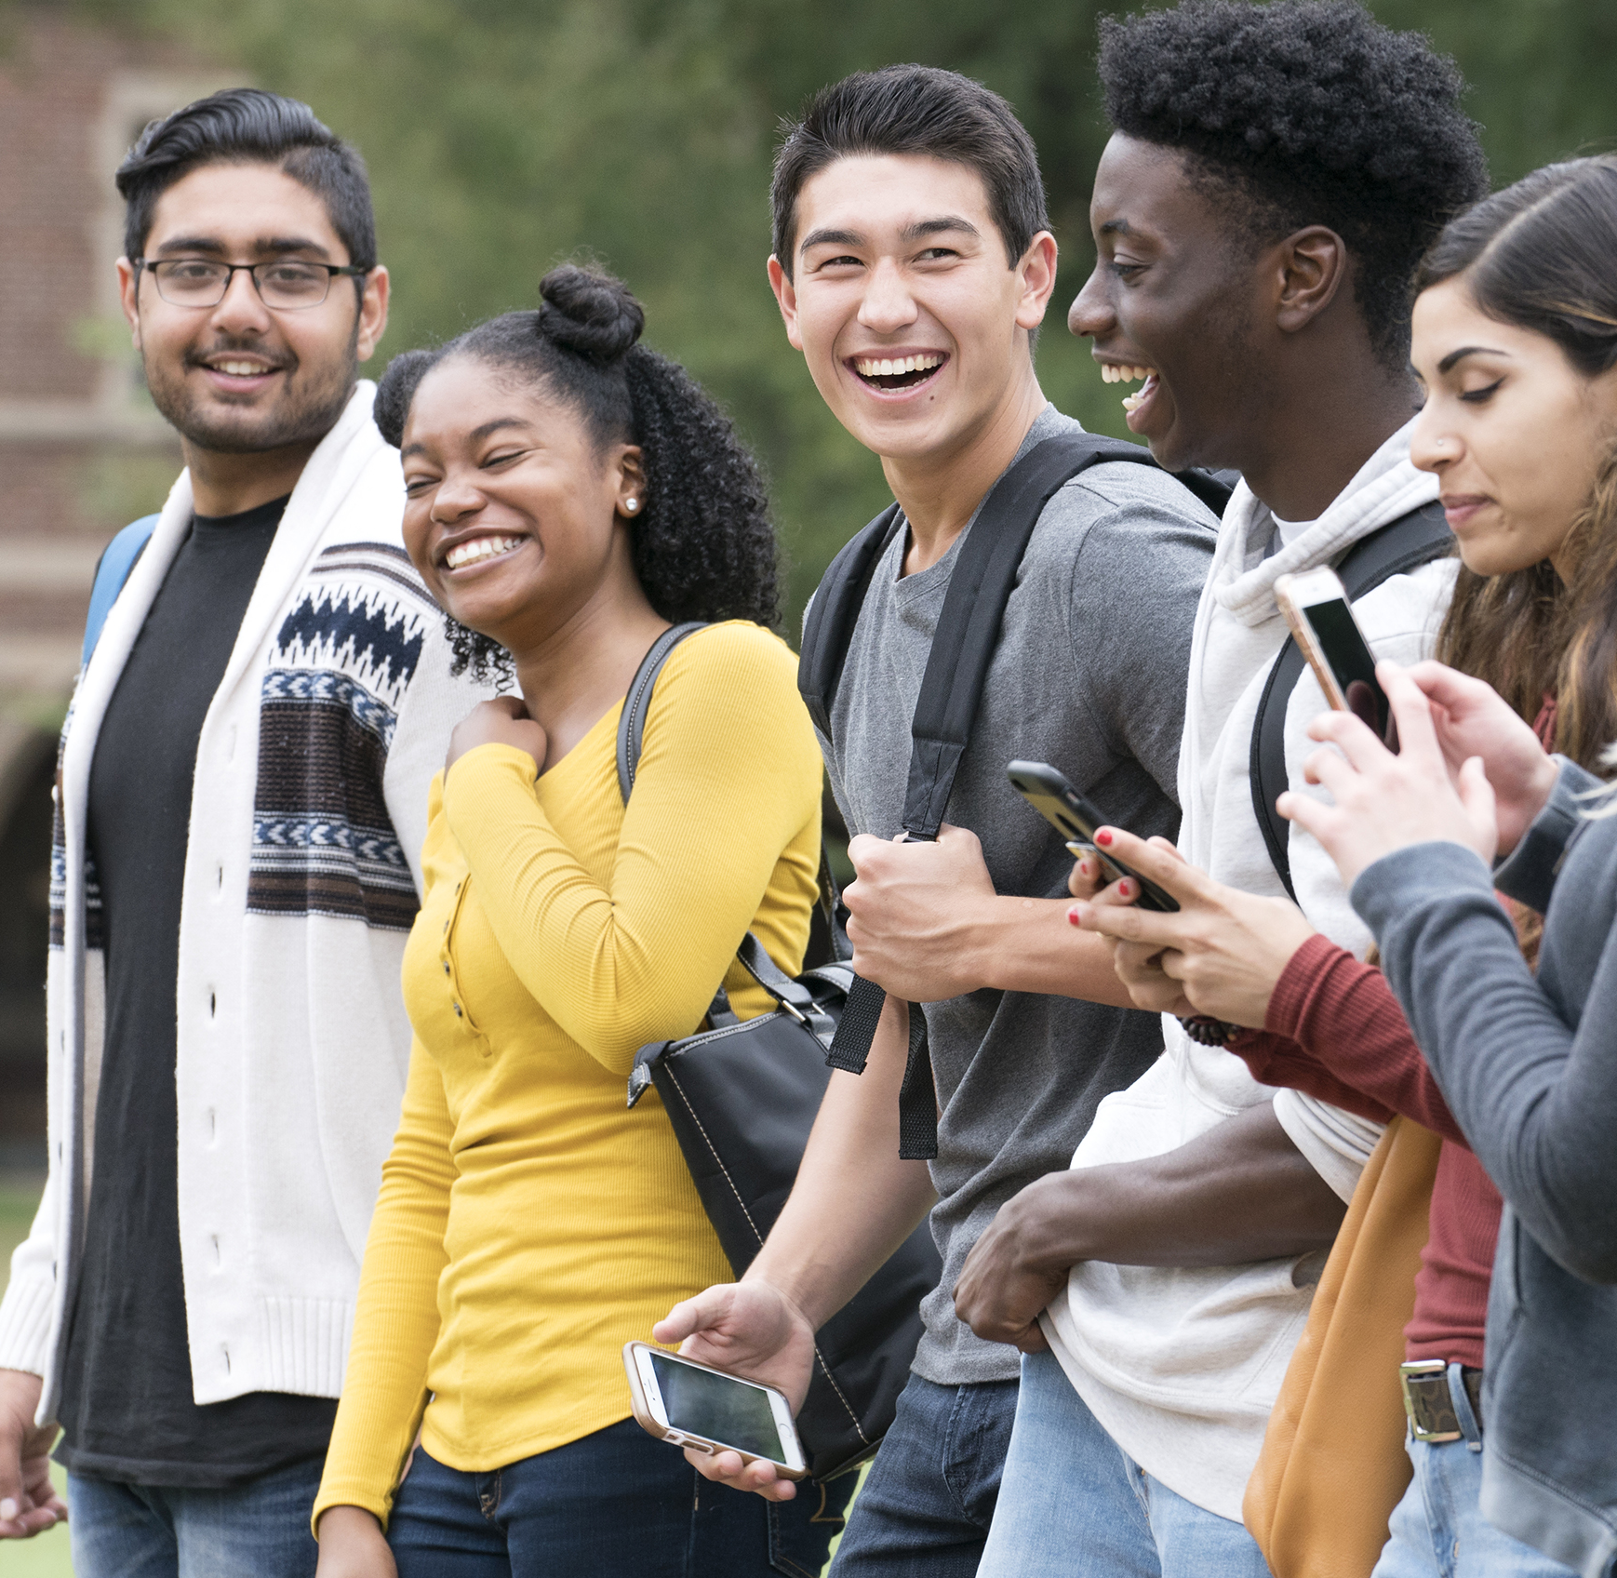
RSHE - what do you think?
Insert school logo here
Notes:
Notes:
Today we are going to be thinking about RSHE. RSHE, stands for relationships, sex and health education and is intended to help young people to be safe, healthy and prepared for life's opportunities. Re-cap with pupils the different topics that are covered in RSHE and remind them about previous work they may have done on friendship, different kinds of families, taking care of their bodies, puberty and the changes that happen, feelings, different communities, asking for help etc

Slide 3
We are going to explore:
What RSHE is and why we do it
How we can improve RSHE
What you want to learn in RSHE
Notes:
Notes:
“We are going to explore what RSHE is, why it is so important to do in school and what we can do to make it as good as it can be for you. I am looking forward to learning from you.”

Slide 4
Warming up
It’s OK not to be a ‘know it all’
Notes:
Notes
Tell pupils to sit or stand in a circle, with one pupil in the middle who says something that they know lots about. Examples are: making pizza, playing football, braiding hair, playing computer games, baking a cake. If the suggestion is not something pupils know lots about, they run across the circle, swapping places with other pupils. The last pupil to find a place takes their turn in the middle. At the end of the game reassure pupils that there are always things that we need to learn more about and today it is fine not to be a ‘know it all’, as they are going to be learning about things that they may not have been taught much about before.

Slide 5
RSHE helps you to be healthy, happy and safe
Families
Respectful relationships
Online and media
Emotional wellbeing
Internet safety and harms
Being safe
Staying healthy
Basic first aid
Changing adolescent body
Notes:
Notes:
“RSHE stands for relationships education, sex education and health education. Each school teaches RSHE differently because each school and the pupils, their families and teachers are different. It’s really important that schools are teaching pupils what they need to know to stay healthy, happy and safe. We think we know what that is but it makes RSHE even better when you tell us what you want to learn, what you need to learn and how you want to learn it. There are lots of ways you can tell us and we really value what you tell us. It will shape what we teach, when we teach it and how we teach it.”

Slide 6
A group agreement
Notes:
Notes:
A class contract can help everyone feel safe to join in with RSHE as it sets out rules; things that are okay and things that are not okay. It’s a way for your class to agree some behaviours for the RSHE lessons.
What would you like to see included on the class contract?

Slide 7
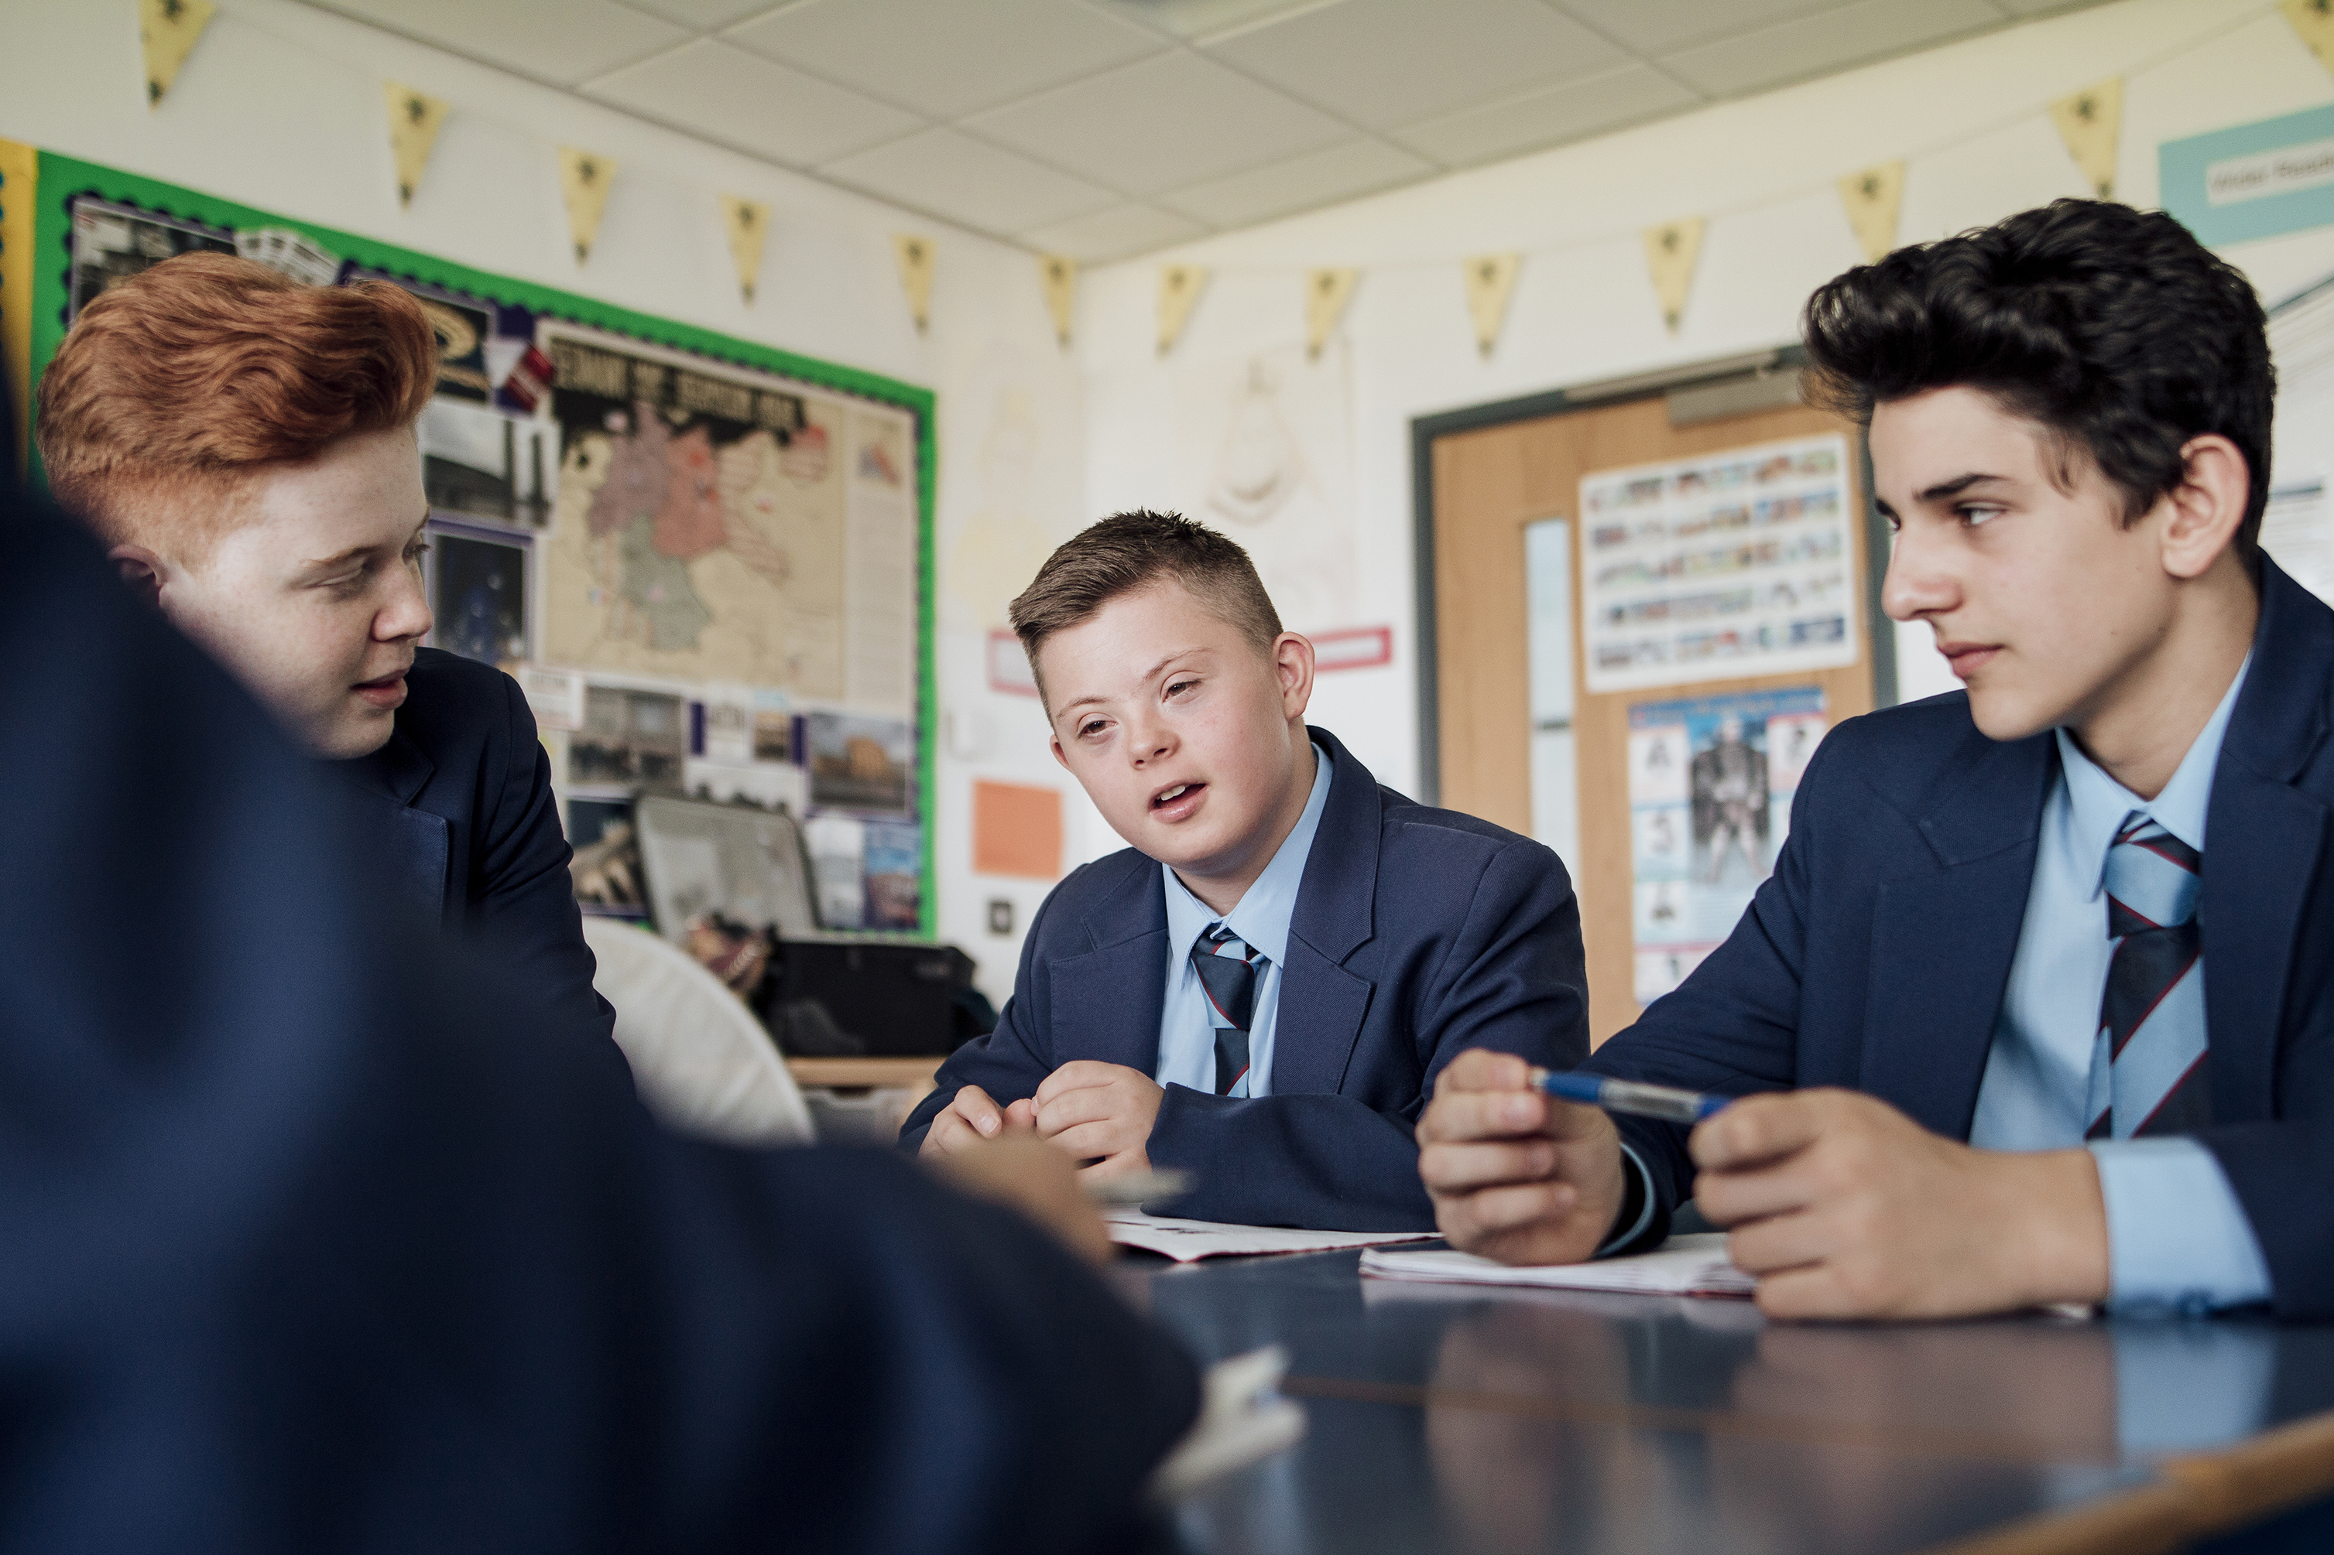
What’s in a name?
Notes:
Notes:
“‘RSHE’ can be hard to remember and might not be the most fun name. Thinking about the different things you learn in RSHE, what do you think would be a better name?”
You can always come back to this later once RSHE has been explored a bit more.

Slide 8
Main issues that children and young people talk to Childline about.
Emotional wellbeing and mental health
Family relationships
Bullying
Friendship issues
Sex, relationships and puberty
Problems in school or with education
Sexual abuse (including online sexual abuse)
Physical abuse
Notes:
Notes:
“Emotional wellbeing and mental health; Low self-esteem, lack of confidence, anxiety, feeling sad, low mood, lonely, mental health issues, loss and bereavement
Family relationships; Conflict/arguments with family members, parents’ divorce/separation.
Bullying; Peer-to-peer bullying, either face-to-face or online.
Friendship issues; Falling out with friends, difficulty making friends.
Sex, relationships, puberty or sexual health; Sexual development, relationship issues, body changes, sexually transmitted infections (STIs), contraception etc
Problems in school or with education; Exam pressures, concerns about performance, not coping with workload, dislikes school, new school worries, problems with teacher, truancy.
Sexual abuse (including online sexual abuse); The child has been forced or persuaded to take part in sexual activities. This doesn’t have to be physical contact and it can happen online.
Physical abuse; Young person is at risk of, or has experienced physical abuse. This includes physical punishment”
The main concerns give us a good idea of what children and young people are contacting Childline about, but this only gives a snapshot of their concerns. Collecting information on how your concerned your cohort is on these issues is very useful but it is important that you collect it in a way that all pupils feel comfortable with. One suggestion is the spectrum technique- pupils rate how concerned they are about each one, 1-5, 5 being the highest. Give them the list to cut up and arrange- they could do it individually, in a group. It is important that there is distance in this activity and they are reporting on what they think pupils from this school are concerned about,

Slide 9
Some of the things we learn in RSHE
Coping with change
Healthy bodies, healthy minds
Families
Caring and responsibility
Similarities and differences
Healthy and happy friendships
Notes:
Notes:
“These are some of the things we learn about in RSHE; I have put pictures of them on a graffiti wall, titles ‘I want to learn more about’. Put ticks next to the things you want to learn more about. You can write any other suggestions on the wall.”
Pupils record ideas using board markers, which have been attached to string and pinned onto the board, or by writing onto post-it notes which are then stuck on. If inappropriate content is added, simply cover-up with black marker.

Slide 10
What makes a good RSHE lesson?
Notes:
Notes:
“What makes learning fun?
What resources have you used that were good?
How do we know if we are learning?
What makes a good RSHE teacher?
How can we ask for help?
Who would you speak to if anything in the lesson made you feel uncomfortable?”
You could collect this info in different ways- assign different questions to different groups then ask them to present to the larger group.

Slide 11
What would you like us to know?
Notes:
Notes:
“Are there any other things you are interested in learning about in RSHE? Is there anything you would like us to know that would help us create RSHE lessons that help you to be as happy, healthy and safe as possible?”
Create the ‘basket’ and put it in an accessible place, tell pupils when it will be checked and how entries will be responded to. They can add their name if they want but usually entries would be anonymous.

Slide 12
Positive thoughts and affirmations
I am open and ready to be positive
I deserve to be happy
I make good choices
It is okay if I make mistakes
I like myself for who I am
I am in control of my feelings
I make a difference in the world
Today is going to be a great day
Notes:
Notes:
“One of the main aims of RSHE is to support your wellbeing and a great way to do that is to use positive self talk. Have a look through these positive thoughts and affirmations. Hopefully one or two will help you. If you have any affirmations you already use, I would love to hear them; pop them in the ask it basket”.

Slide 13
Thank you
Thank you!
Notes:
Notes:
“If you have any other ideas, share these with your class teacher, draw or write them and pop them in the ‘ask it’ basket.”
Thank pupils for their contributions, highlighting any common or key points that have been made. It is recommended that you confirm how confidentiality will be maintained with any wider sharing of the findings, such as with school governors, parents, SLT etc.

