Slide 1
Schools Forum – High Needs Block national updates
High Needs Block Consultation
Covid – Specialist Provision Ministerial Letter
National SEN Review
DfE consultation end date 24 March 2021
Minster’s letter to C&YP and Families for SEND
Likely consultation 2nd half of summer term

Slide 2
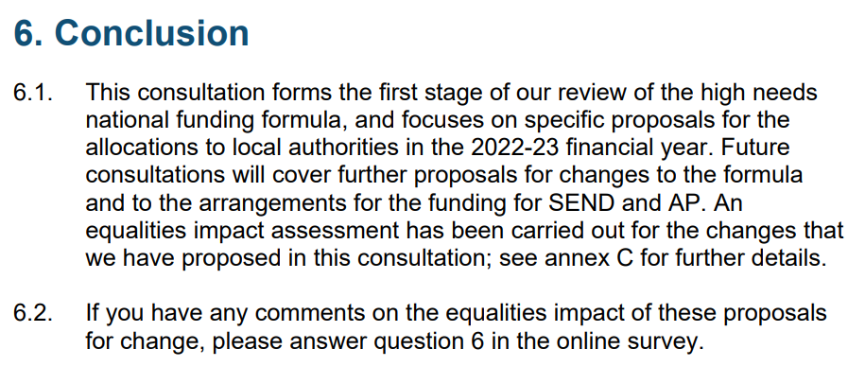
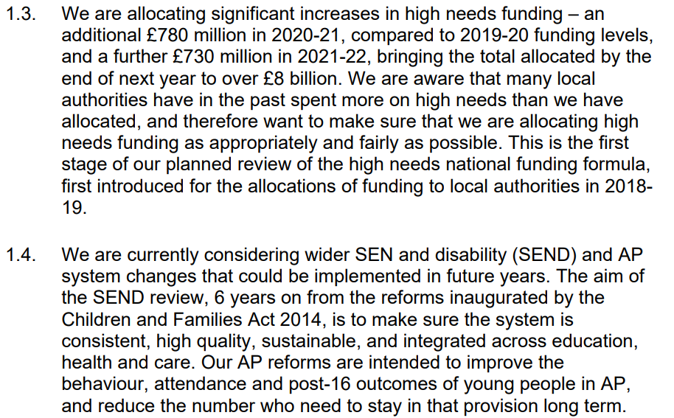
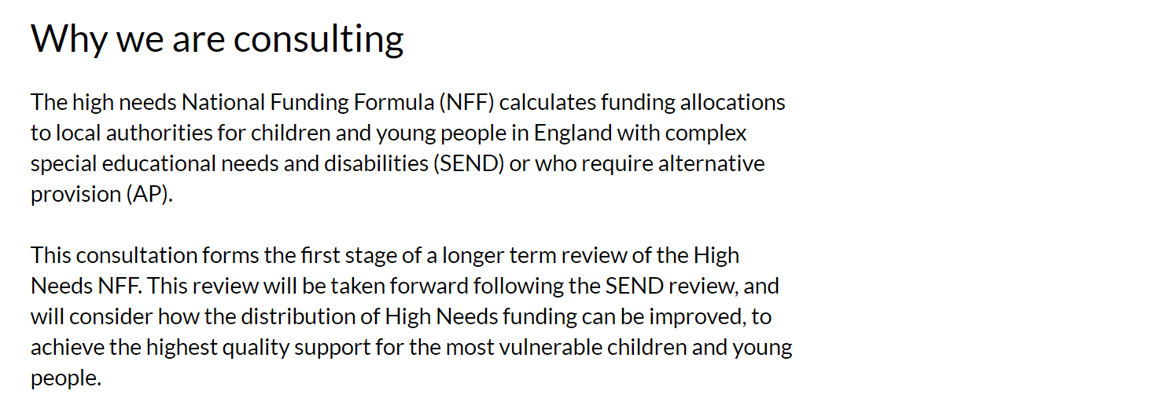
DfE HNB proposed changes, Section 6 conclusion

Slide 3
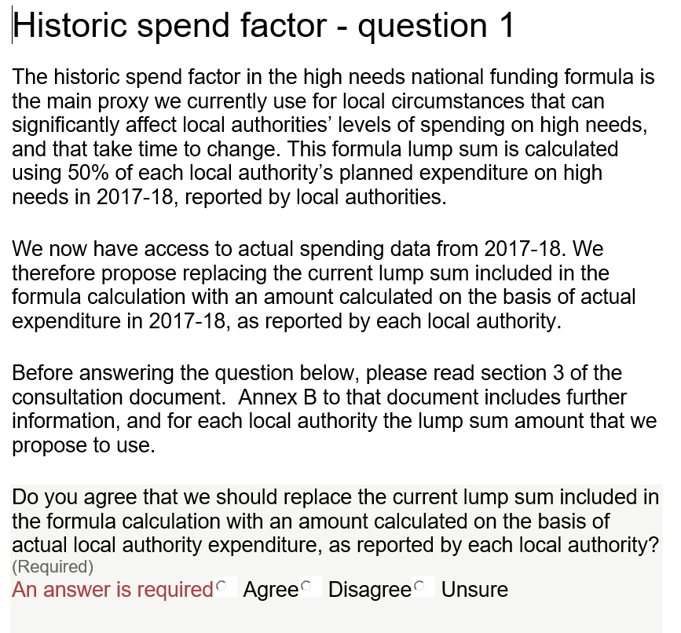
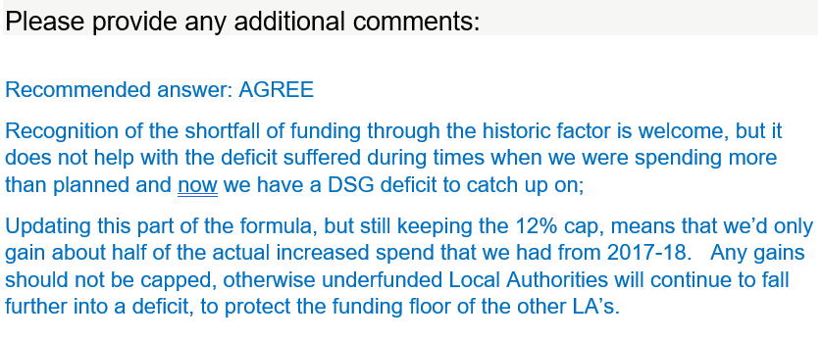
Historic spend factor question 1

Slide 4
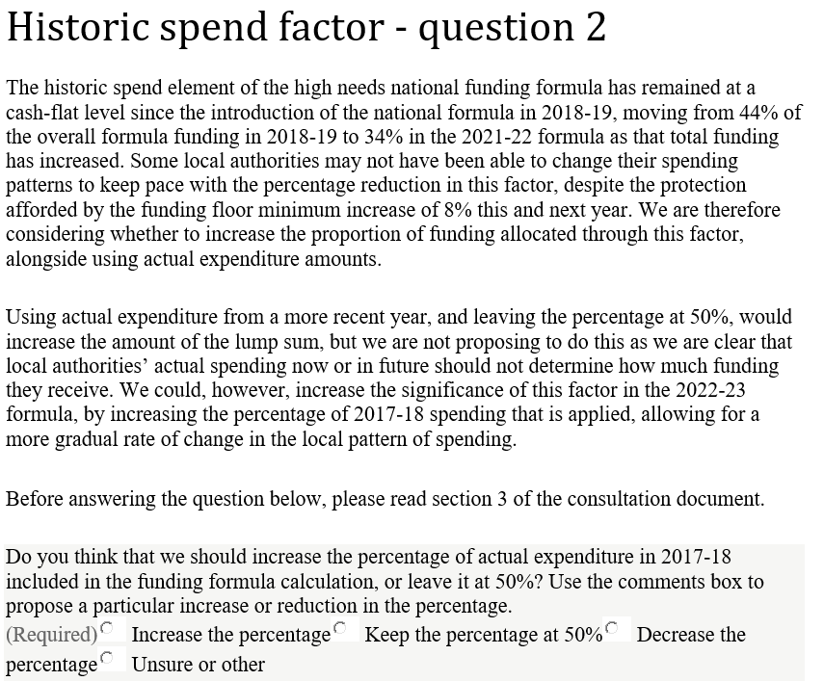
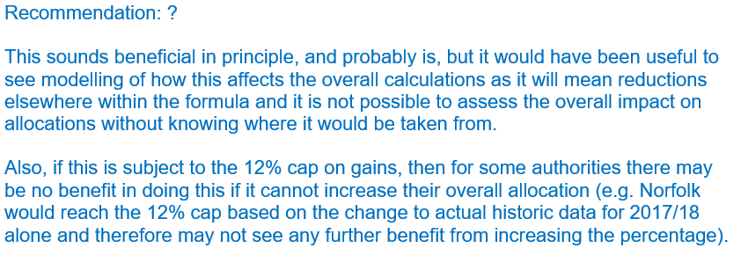
Historic spend factor – question 2

Slide 5
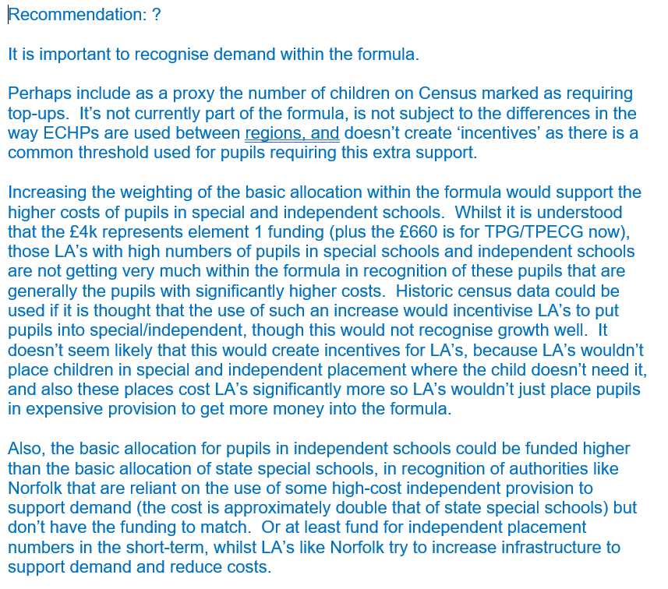
Historic spend factor – question 3

Slide 6
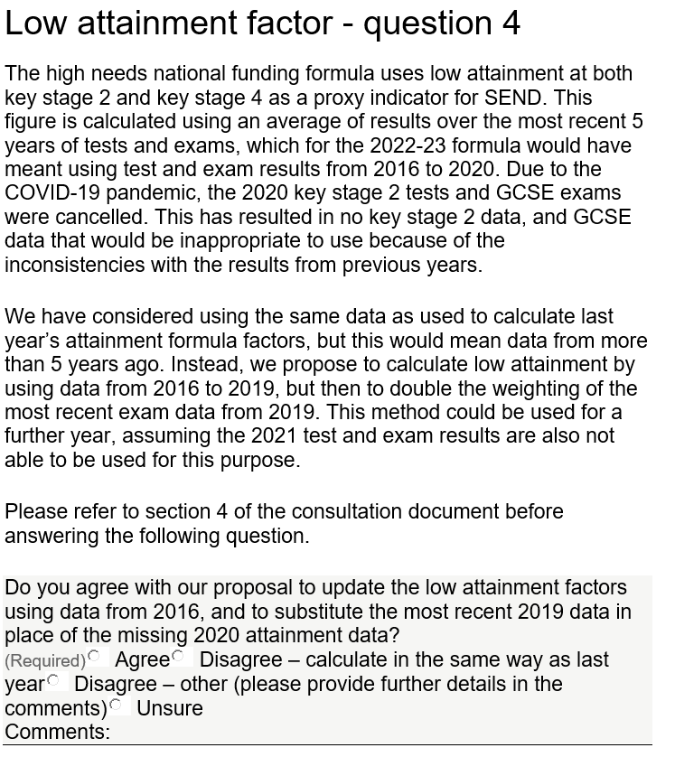
Low attainment factor - question 4

Slide 7
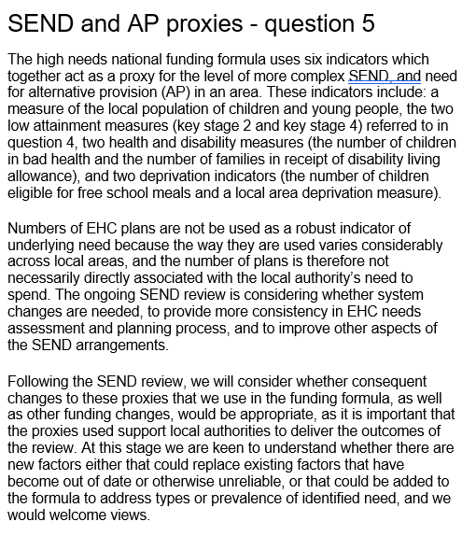
SEND and AP proxies – question 5

Slide 8
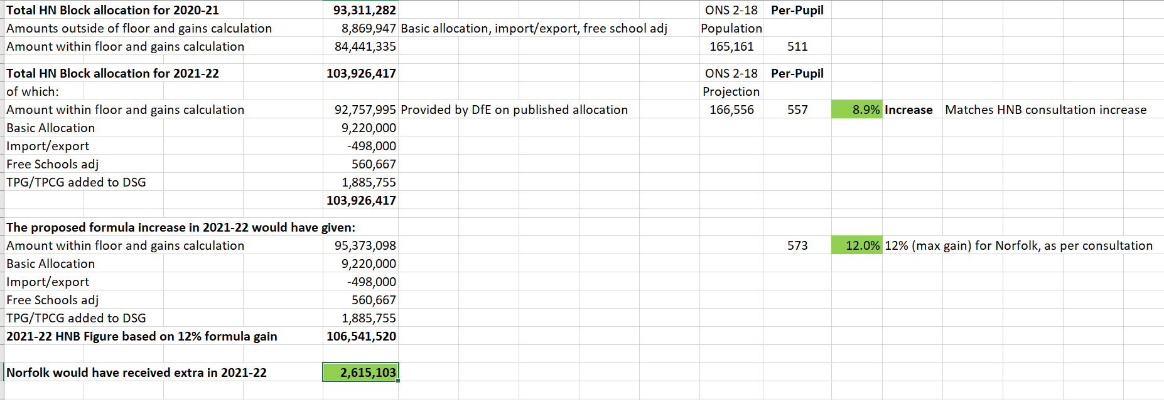
Norfolk figures – expenditures, proposed, etc

Slide 9
Education recovery

Slide 10
The SEND Review is just the first stage of a long-term set of reforms, learning from the successes and challenges of the past six years.
The SEND Review wants to achieve three goals​:
To improve the outcomes children and young people achieve: Meaning a renewed focus on what works, quality first teaching, finding and addressing needs early, and offering help faster than we currently can.
Finding ways of being more financially sustainable: Making big improvements to early intervention focusing our precious time, energy, funding and expertise where it will make most difference; supporting children and young people, rather than paperwork.
Improving everyone’s experience of this system: Looking at ways to lead culture change; everyone involved in the system should be treated with empathy and respect.
Based on the evidence and feedback from our partners, we think that the future system should operate at three levels:
A better universal offer for those with needs which can and should be met in mainstream
We want to make better use of the screening tools we have so we can identify and help children and young people if they begin to fall behind.
We will find ways to help mainstream schools make the best use of the expertise they have, so they can get good specialist advice and help quickly, and make both the funding and accountability reflect that new role.
Work for those needing more targeted support:
Where children need additional support, we will explore ways to make best use of precious expertise so they can get
specialist advice and support quickly, and again – make the funding and accountability reflect that.
We will improve and streamline the EHCP process, so children who require that additional support can get the help they need more easily.
Work for those with the most specialist and challenging needs:
We will explore best practice in getting agencies across education, health and care to work together, to make sure specialist help and placements are available close to home.

