Slide 1
Identification of need and inclusive provision
Using the INDES and IPSEF effectively in your setting
inclusionandsend@norfolk.gov.uk

Slide 2
Support for facilitators
This PowerPoint has been created to support settings to introduce and implement the INDES with their staff.
Each setting is unique. Please adapt this presentation to suit your individual setting and approach. (Remember to modify the contents page accordingly!)
The appendix (slide 26) contains guidance and examples to support facilitation. These slides are not intended to be used during presentation to staff.
Further support and advice is available by contacting the Inclusion and SEND team:
INDES and IPSEF support – indesipsefsupport@norfolk.gov.uk
General enquiries - inclusionandsend@norfolk.gov.uk
SEND funding case-specific enquiries – element3funding@norfolk.gov.uk
Notes:
Delete/move this slide to the end when presenting to colleagues.

Slide 3
Session outline…
Overview
What are the INDES and IPSEF?
Benefits of use
Overview: INDES, IPSEF and PEaSS
Reflection on current processes
INDES (Identification of Need in Educational Setting)
INDES Overview
INDES Shared example
INDES data collection tool
Submitting the INDES
Ensuring Provision meets need: IPSEF and PEaSS
IPSEF (Inclusion and provision self-evaluation framework)
PEaSS
PEaSS Shared Example

Slide 4
What are the INDES, IPSEF
and PEaSS?…
The Identification of Needs Descriptors in Educational Settings (INDES) and the Inclusion and Provision Self‐Evaluation framework (IPSEF) are two tools which provide a commonality of language and shared understanding of the presentation of special educational needs in education settings and establish a context for making provision inclusive.
These tools dovetail with Norfolk’s Provision Expected at SEN Support (PEaSS) suite of resources:
Provision Expected at SEN Support (PEaSS) guidance - Norfolk County Council
Notes:
In today’s session we will be looking at two tools produced by Norfolk County Council which support the identification of need and the planning of provision for children and young people with Special Educational Needs and Disabilities. We will look at these tools alongside the PEaSS suite of resources.

Slide 5
Benefits of use…
Commonality of Language
Shared understanding
Describe provision and need consistently across settings
Establishing a context for making
provision inclusive
Using the INDES helps a setting identify patterns of need and where provision is needed
Use alongside PEaSS suite of
resources
Resources and signposting to support needs identified using the INDES
Supports accurate information sharing upon transition
Identify the full scope of a CYP’s profile of need
Using IPSEF supports a whole setting approach to inclusive education
Notes:
The INDES provide a commonality of language and shared understanding across all Norfolk settings. They support us to accurately identify an individual’s needs (which may span a number of different areas) and plan effective provision to meet those needs. Crucially, these tools enable us to gain a clear picture of the profile of needs across different groups: a class, cohort, school or group of schools. This means that we can ensure that our ethos, environment, curriculum and pedagogy meets the needs of our children and young people.

Slide 6
Overview: INDES, IPSEF and PEaSS …
INDES
Identification of Needs Descriptors
in Educational Settings
Individual pupil needs
Identification of pupil specific needs. Completing for every CYP supports identification of needs across cohorts/whole school to inform provision and CPD
IPSEF
Inclusion and Provision
Self-Evaluation Framework
Whole school provision evaluation
Whole school self-evaluation of inclusive practice and provision
PEaSS
Provision Expected at SEN Support
Setting and individual provision
Strategies and resources to support individuals at a whole school, classroom and SENDCo specific level
Notes:
Here is a brief overview of the tools we will be looking at today. We will focus on the INDES and the PEaSS in more detail as you will be using these regularly in the classroom.

Slide 7
Reflection on current processes…
How do we currently identify need?
Do we have a shared language and consistent process to identify need and plan provision?
Notes:
Let’s spend a little time reflecting on our current processes. (Give time to discuss in pairs/small groups and feed back)
Example prompt questions in appendix.

Slide 8
INDES (Identification of Needs Descriptors in Educational Settings) …
The INDES are a set of descriptors used to identify an individual CYP’s profile of need.
They are divided into seven areas:
Deafness
Visual Impairment
Physical Disability
Speech, Language and Communication Needs
Social Communication and Interaction
Learning and Cognition Difficulties
Social, Emotional and Mental Health
Each area has 7 levels which indicate increasing occurrence and/or complexity of need.
Complete INDES webform
INDES descriptors table
Handout
Notes:
The INDES are divided into 7 areas. Each area has 7 levels which increase in complexity. Look at your handouts (can use either full webform, tabular format or both) and take a couple of minutes to familiarise yourself with the INDES statements. Further guidance is available for the speech and language section.

Slide 9
INDES and the four broad areas…
Speech and Language
Learning and Cognition Difficulties
Social, Emotional and Mental Health
Deafness
Social Communication and Interaction
Visual Impairment
INDES Areas of Need
Physical Disability
Communication and Interaction
Cognition and Learning
Social, Emotional and Mental Health
Physical and Sensory
Four Broad Areas of Need
Notes:
This diagram demonstrates how the 7 INDES areas relate to the 4 broad areas of need.

Slide 10
Shared example…
Polly is 9 years old.
Polly’s speech and language skills are delayed by 12 months. She has difficulties with attention and listening and understanding (especially inference).
Polly finds dealing with change difficult. She can become distressed when changing from one activity to the next.
Polly is very sensitive to noise and certain textures. She finds busy spaces overwhelming, including assemblies and the canteen. She has ear defenders.
Polly prefers to play on her own at playtime – playing fairies which is based on a tv show she likes. With adult support, she can play alongside others if the rules of the game are clear.
Polly is a fluent reader and imaginative writer. She has good mental maths skills. Often, she struggles to start independent work as she misses verbal instructions. When this happens, she can become very anxious.
Polly often needs support to organise her belongings and frequently forgets her reading book/homework.
Complete INDES webform
INDES descriptors table
INDES guide to complete SLCN section
Shared example - Polly
Handout
Notes:
PRIMARY EXAMPLE:
Let’s look at an example of an INDES profile for a CYP. Read through the outline of Polly’s needs on the handout. Compare her needs to the statements on the INDES. Which apply to Polly?

Slide 11
Shared example…
Which statements did you select to describe Polly’s needs?
5. Completed INDES descriptors table
Shared Example Polly
Handout
Notes:
Discussion regarding INDES statements selected. Compare with the example completed INDES descriptors table. A useful point to note is that “Polly” is not a real child and we have limited information about her needs. When completing an INDES for a child known to us, it is important we have a comprehensive understanding of their needs, both in and outside the classroom.

Slide 12
Shared example…
Jake is 14 years old
Jake enjoys PE but finds most other areas of learning difficult, especially reading and writing.
Jake finds it difficult to remember verbal information and instructions. He often finds it difficult to retain information given by the teacher and becomes frustrated if he does not know what to do.
Jake can become heightened very quickly, especially in lessons he finds difficult. During these times, he often becomes angry with adults or leaves the classroom and walks around the school site.
Jake is friends with CYP in the year below him. He has frequent verbal and physical altercations with peers. It is reported that he instigates these.
With known adults on a 1:1 basis, Jake can start to talk about how he is feeling and what he finds hard, although he finds this very difficult. He voices that he thinks teachers hate him, no one helps him, the work is too hard and that everyone else can do it apart from him.
Jake has adult support for English and maths lessons. He accesses the school “hub” where he checks in with a member of pastoral staff each morning. He can use this as a regulation space when heightened.
Complete INDES webform
INDES descriptors table
INDES guide to complete SLCN section
6. Shared example - Jake
Handout
Notes:
SECONDARY EXAMPLE:
Let’s look at an example of an INDES profile for a CYP. Read through the outline of Jake’s needs on the handout. Compare her needs to the statements on the INDES. Which apply to Jake?

Slide 13
Shared example…
Which statements did you select to describe Jake’s needs?
7. Completed INDES descriptors table Shared Example Jake
Handout
Notes:
Discussion regarding INDES statements selected. Compare with the example completed INDES descriptors table. A useful point to note is that “Jake” is not a real child and we have limited information about his needs. When completing an INDES for a child known to us, it is important we have a comprehensive understanding of their needs, both in and outside the classroom.

Slide 14
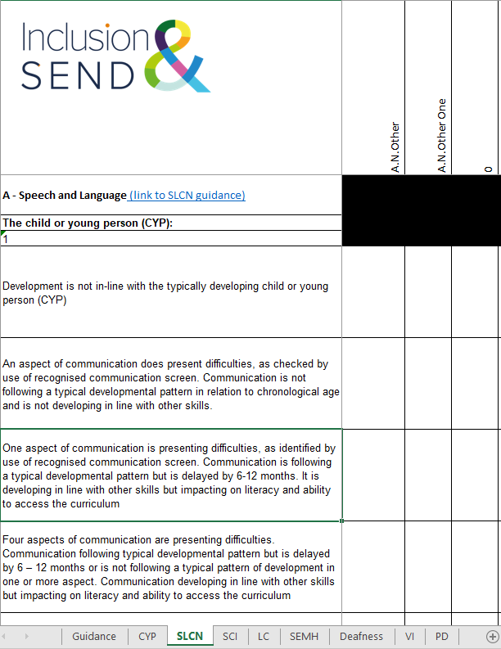
INDES data collation tool …
When collating INDES submissions from across a setting, the INDES data collation tool can be used to collate all the information needed to provide a profile of need for a cohort of children and young people.
This may be useful for secondary settings where multiple staff may be contributing. The data collation tool can be used to complete individual INDES webforms.
Examples of how a settings used the data collation tool are included in the INDES implementation guide case studies.
INDES data collection tool
Notes:
The INDES data collection tool is optional.

Slide 15
Submitting the INDES …
Click on the link to the INDES webform on the Norfolk Schools’ website: Identification of needs descriptors in educational settings (INDES) - Schools (norfolk.gov.uk)
Ensure you have the necessary information to hand as you will not be able to save your progress once you have started to fill in the form.
CYP’s first and last names,
CYP’s date of birth
Unique Pupil Number/Early Years number
Supporting evidence ready to upload (SEN Support plan, health care plan and/or EHC plan – see below for further guidance on uploading evidence)
SENDCo full name and email address
Head/Principal full name and email address
Detailed guidance on submitting the INDES is available in the INDES implementation guide.

Slide 16
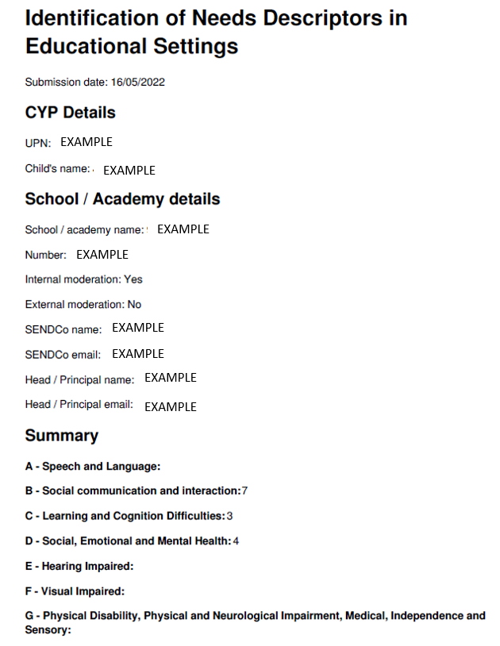
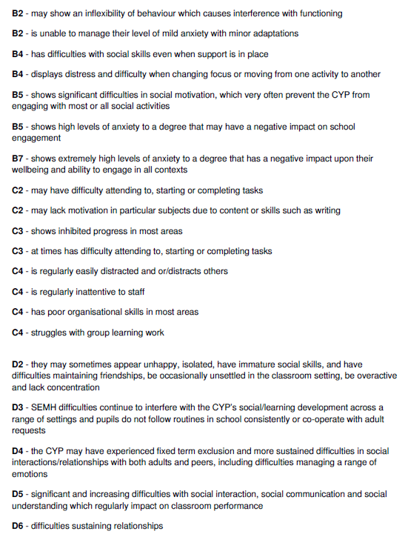
Submitting the INDES Individual INDES Summary emailed to setting following submission …
Summary of statements ticked
Overall "iLevels" for each section: 0-7
No number = 0
Individual INDES Summary provided to school following submission
Notes:
Following an individual INDES submission, a PDF summary will be emailed to the SENDCO/Headteacher. This includes an overall score/7 for each section and a summary of all statements selected.

Slide 17
Implementing the INDES …
Key Question | Our setting’s approach | Key dates
For which CYP will we complete an INDES?
Who will complete the INDES?
Who will submit the INDES?
How will we use the INDES to review and plan provision?
How often will we review the INDES?
How will we moderate the INDES? (Internally and externally?)
Notes:
Use this slide to frame discussions around how INDES will be implemented in your setting

Slide 18
Ensuring provision meets need
IPSEF
(Inclusion and Provision Self-Evaluation Framework)
PEaSS
(Provision Expected at SEN Support)
What special educational need (SEN) Support we expect places of learning to provide for children and young people with special educational needs and disabilities (SEND)
What parent carers can expect their child’s places of learning to provide
A whole school framework to evaluate provision to support inclusive practice.
Notes:
The IPSEF is a tool which settings can use to evaluate their provision and ensure that it meets the needs identified through the INDES. It is a whole school framework. The PEaSS provides strategies and resource links settings can use to tailor provision to meet individual need.

Slide 19
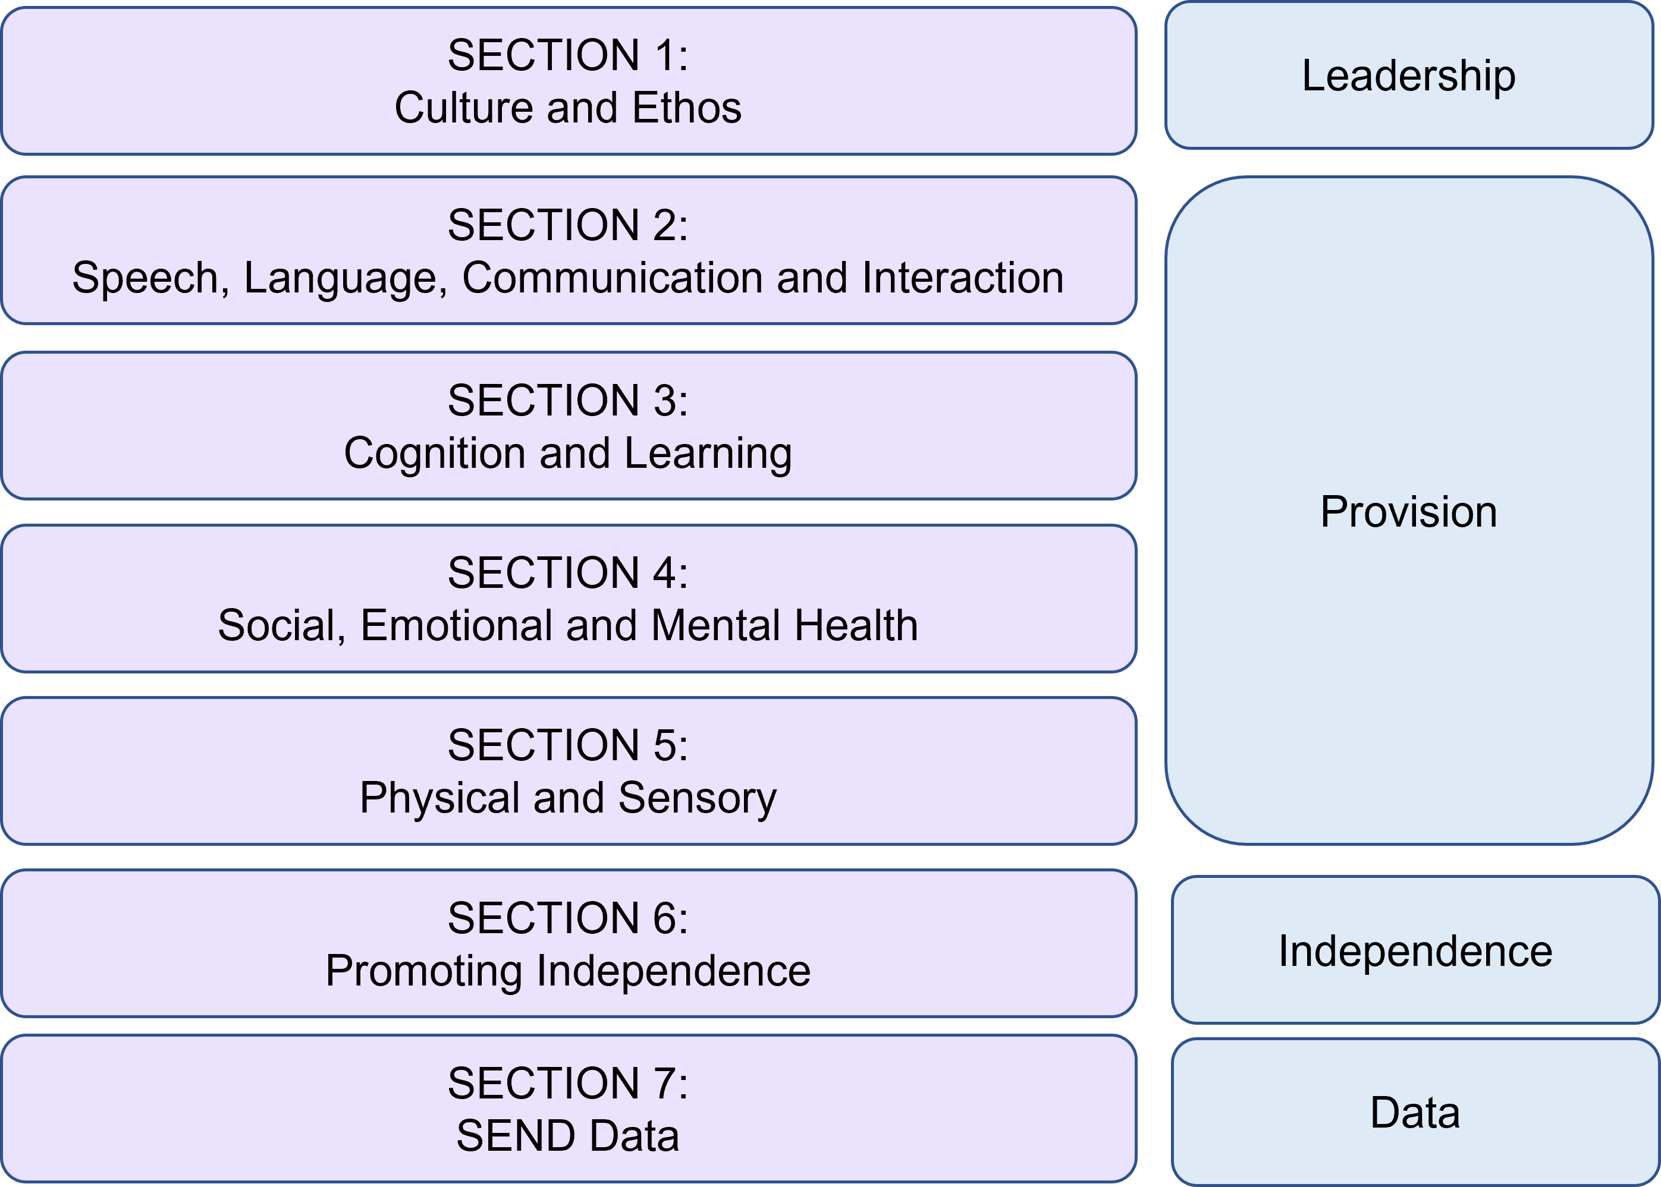
IPSEF (Inclusion and Provision Self-Evaluation Framework) …
Notes:
The IPSEF consists of 7 sections. These focus on the culture and ethos of the school, the provision, how a setting builds independence and key data relating to SEND. The tool enabled settings to identify where provision is strong and meets need as well as where provision needs to be developed further.

Slide 20
IPSEF (Inclusion and Provision Self-Evaluation Framework) …
Culture and Ethos
INEFFECTIVE - The setting’s curriculum does not take into consideration all learners and their needs. Leaders are unsure about the quality of teaching overall and do not support teachers in planning inclusive lessons
TAKING ACTION - The setting’s curriculum takes into consideration most learners and their needs. Leaders have monitoring systems in place, but these do not inform CPD for teachers needing support in planning for all
EFFECTIVE - The setting’s curriculum is good and developing towards outstanding in its intent. Leaders have monitoring systems in place that support teachers in their planning, but this is still in its developmental stage
LEADING - The setting’s curriculum is outstanding and designed to meet the needs of all learners. Leaders have a clear process for monitoring its implementation and supporting teachers to confidently plan highly inclusive lessons which enable all pupils to progress
1.04 : Leaders place high value on the quality of the setting’s curriculum in its intent to provide a quality education for all pupils and in its implementation, by teachers who are confident to plan to meet the needs of all CYPs
Example of IPSEF statements and judgements: Culture and Ethos
Notes:
The IPSEF consists of a series of statements which settings can judge themselves again. Judgements are organised into four categories from ineffective to leading. This is an example of a culture and ethos statement.

Slide 21
IPSEF (Inclusion and Provision Self-Evaluation Framework) …
Provision
INEFFECTIVE - Teachers and support staff are not able to identify learners with SLCN. Staff have had little or no training around SLCN needs
TAKING ACTION - Teachers and support staff can identify learners with SLCN but are not confident with strategies or interventions to help learners overcome these barriers. Staff have been trained and are broadly confident in identifying needs
EFFECTIVE - Teachers and support staff can identify learners with SLCN and are confident in identifying strategies and interventions to help learners overcome these barriers. Staff are trained and are confident in identifying needs and knowing the next steps
LEADING - Teachers and support staff can identify learners with SLCN and use a wide range of strategies and interventions to help learners overcome these barriers. Staff are trained and confident in identifying need and take action swiftly to remove barriers
2.02 The setting identifies learners with speech, language and communication (SLCN) needs and uses appropriate strategies and interventions to help learners overcome these barriers
Example of IPSEF statements and judgements: Provision
Notes:
This is an example of a provision statement.

Slide 22
IPSEF (Inclusion and Provision Self-Evaluation Framework) …
Independence
INEFFECTIVE - No additional support is provided for transition at key points. Communication between settings is minimal
TAKING ACTION - Some additional support is provided for transition at key points e.g. extra visits. Communication between settings takes place. Those CYPs with the highest level of need are confident about moving to their new setting but others may not feel as confident
EFFECTIVE - A range of additional support is provided at key points e.g. extra visits; photo books. Communication between settings is effective and most CYPs are confident about moving to their new setting
LEADING - A wide range of additional transition support is available at key points e.g. extra visits; photobooks; wider liaison between providers. Communication between settings is highly effective. All CYPs are confident about moving to their new setting
6.03 : Transition between stages of education is effective
Example of IPSEF statements and judgements: Independence
Notes:
An example of an independence statement.

Slide 23
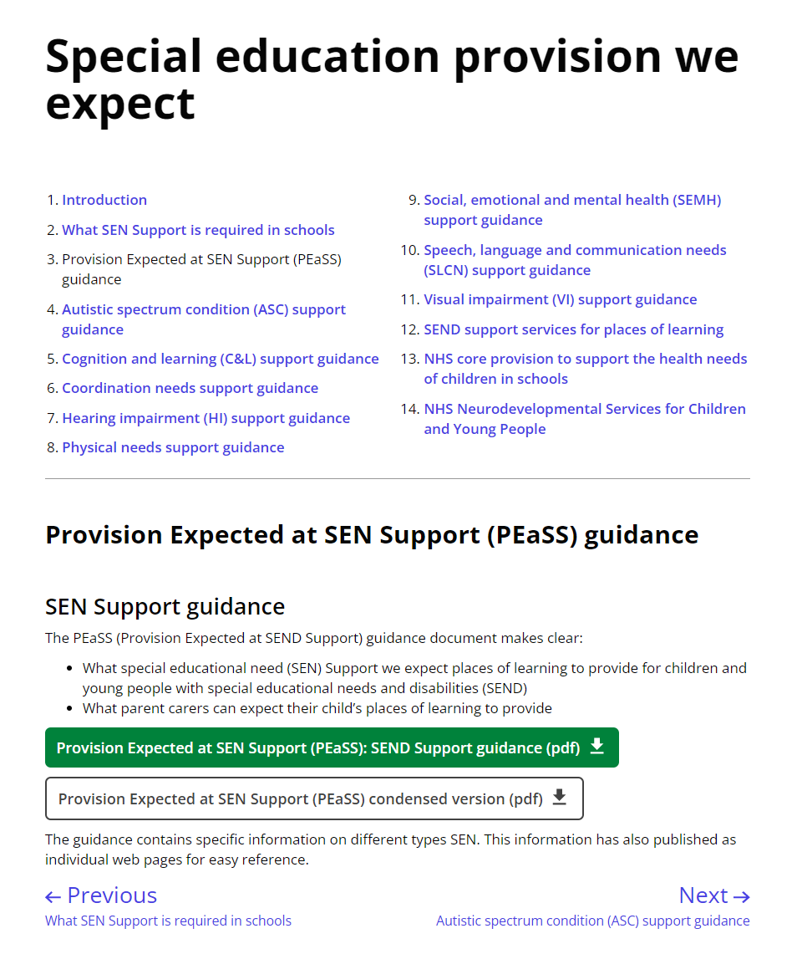
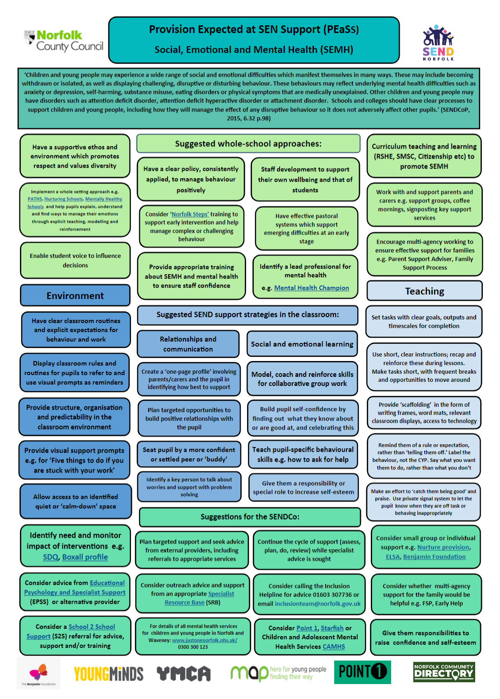
PEaSS (Provision Expected at SEN Support)
Posters contain hyperlinks to strategies to try and key sources of guidance or resources
Provision Expected at SEN Support
PEaSS posters
Handout
Notes:
The PEaSS provides strategies and resource links for settings. It is important that staff are familiar with the PEaSS so that they can tailor teaching strategies, resources and curriculum to meet an individual’s needs. PEaSS posters are available (currently on the Inclusion and SEND Learning Network Sharepoint site) as a quick reference guide,

Slide 24
Shared example…
Choose one section of the PEaSS to focus on.
What provision does Polly require to meet her needs?
What high quality teaching strategies would be beneficial for her?
How might you adapt the curriculum to meet her needs?
4. Shared example - Polly
Provision Expected at SEN Support
PEaSS posters
Handout
Notes:
Use the PEaSS to identify provision and strategies which would meet Polly’s needs. Further guidance/example is available in the appendix.

Slide 25
Shared example…
Choose one section of the PEaSS to focus on.
What provision does Jake require to meet his needs?
What high quality teaching strategies would be beneficial for him?
How might you adapt the curriculum to meet his needs?
6. Shared example - Jake
Provision Expected at SEN Support full version
PEaSS posters
Handout
Notes:
Use the PEaSS to identify provision and strategies which would meet Jake’s needs. Further guidance/example is available in the appendix.

Slide 26
Any Questions?…
Notes:
Questions and conclusion.

Slide 27
Appendices
Example slides to support facilitators
Slide 7: Reflection on current processes
Slide 11: INDES Shared Example discussion: Polly
Slide 13: INDES Shared Example discussion: Jake
Slide 17: Implementing the INDES
Slide 24: PEaSS Shared Example: Polly
Slide 25: PEaSS Shared Example: Jake
Notes:
The following slides provide further examples and guidance for facilitators and are not intended to be presented to staff.

Slide 28
Reflection on current processes…
How do we currently identify need?
Do we have a shared language and consistent process to identify need and plan provision?
Key Questions to consider which may aid in facilitating discussion:
How does our setting’s/multi-academy trust’s policy outline how we identify need?
Does our SEN Information Report outline how we identify need? Is this communicated clearly to parents/community?
What does the APDR cycle look like in our setting? Who is involved in re-assessing need and reviewing provision regularly? Is it effective?
What regular training is in place for staff?
Do SLT and the SENDCO model and embed consistent, positive language when describing SEND? How is negative/offensive language challenged? (Even if offense is not intended.)

Slide 29
Shared example…
Draw out key words and phrases with staff (examples in bold.) What does this tell us about Polly’s needs?
See CYP Case Study Primary (INDES Implementation Guide p.12) for breakdown of how this description of need relates to INDES statements. (you could also print this and use as an example with staff should you wish.)
Select only the statement which apply to the CYP. Some statements are similar, building in complexity of need from 1-7. Only select the highest applicable statement in this case.
Polly is 9 years old.
Polly’s speech and language skills are delayed by 12 months. She has difficulties with attention and listening and understanding (especially inference).
Polly finds dealing with change difficult. She can become distressed when changing from one activity to the next.
Polly is very sensitive to noise and certain textures. She finds busy spaces overwhelming, including assemblies and the canteen. She has ear defenders.
Polly prefers to play on her own at playtime – playing fairies which is based on a tv show she likes. With adult support, she can play alongside others if the rules of the game are clear.
Polly is a fluent reader and vivid writer. She has good mental maths skills. Often, she struggles to start independent work as she misses verbal instructions. When this happens, she can become very anxious.
Polly often needs support to organise her belongings and frequently forgets her reading book/homework.
Which statements did you select to describe Polly’s needs?

Slide 30
Shared example…
Draw out key words and phrases with staff (examples in bold.) What does this tell us about Jake’s needs?
See CYP Case Study Secondary (INDES Implementation Guide p.17) for breakdown of how this description of need relates to INDES statements. (you could also print this and use as an example with staff should you wish.)
Select only the statement which apply to the CYP. Some statements are similar, building in complexity of need from 1-7. Only select the highest applicable statement in this case.
Jake is 14 years old
Jake enjoys PE but finds most other areas of learning difficult, especially reading and writing.
Jake finds it difficult to remember verbal information and instructions. He often finds it difficult to retain information given by the teacher and becomes frustrated if he does not know what to do.
Jake can become heightened very quickly, especially in lessons he finds difficult. During these times, he often becomes angry with adults or leaves the classroom and walks around the school site.
Jake is friends with CYP in the year below him. He has frequent verbal and physical altercations with peers. It is reported that he instigates these.
With known adults on a 1:1 basis, Jake can start to talk about how he is feeling and what he finds hard, although he finds this very difficult. He voices that he thinks teachers hate him, no one helps him, the work is too hard and that everyone else can do it apart from him.
Jake has adult support for English and maths lessons. He accesses the school “hub” where he checks in with a member of pastoral staff each morning. He can use this as a regulation space when heightened.
Which statements did you select to describe Jake’s needs?

Slide 31
Implementing the INDES example 1 …
Key Question | Our setting’s approach | Key dates
For which CYP will we complete an INDES? | We will complete an INDES for all of the CYP with SEND. We will begin by completing INDES for high needs pupils (those with EHCPs and higher levels of SEN). A list of pupils has been provided for each class. | SM:INDES introduction Oct 22. SM: Complete INDES for HN pupils Nov 22. SM: Remaining INDES: Jan 22
Who will complete the INDES? | Teachers will complete the INDES with support from SENDCO and SLT. | Staff meeting dates above.
Who will submit the INDES? | The SENDCo will work in a group with teaching assistants to submit the INDES. They will be given time out of class to do this. (This could be during assembly/PE lesson) | 2 weeks after each staff meeting.
How will we use the INDES to review and plan provision? | The INDES will be part of the ADPR cycle and will be referred to when reviewing and updating pupil passports and individual learning plans. For each statement ticked we will consider what provision is required using the PEaSS document and discussion with SENDCo. | Termly
How often will we review the INDES? | The INDES will be reviewed termly as part of our APDR cycle. They do not have to filled in again/resubmitted, but teachers will check to ensure that the needs identified are still accurate. | Termly
How will we moderate the INDES? (Internally and externally?) | SENDCO will moderate a sample of INDES each term to ensure accuracy and that they do not need updating to reflect changes in need. We will work with a local cluster of schools to carry out external moderation of the INDES. | Termly
See also Setting Case Study Primary (INDES Implementation Guide p.21) for further guidance on implementing the INDES

Slide 32
Implementing the INDES example 2…
Key Question | Our setting’s approach | Key dates
For which CYP will we complete an INDES? | We will complete an INDES for all of the CYP with SEND. We will begin by completing INDES for high needs pupils (those with EHCPs and higher levels of SEN). | By Oct half term.
Who will complete the INDES? | Heads of year will oversee completion of the INDES for those children in their year group (with support from SENDCO and SLT.) HOYs will introduce the INDES during team meetings and complete two example INDES together. Staff will use the INDES data collation tool. | 2nd half Autumn term. Complete by Feb half term.
Who will submit the INDES? | Admin staff will submit the INDES using the INDES data collation tool for reference. | HNCYP by 18.11.22 All CYP by 10.03.22
How will we use the INDES to review and plan provision? | The INDES will be part of the ADPR cycle and will be referred to when reviewing and updating pupil passports and individual learning plans. For each statement ticked we will consider what provision is required using the PEaSS document. The SEND team will oversee this initially. Year group teams will have greater input over time. | Termly. Year group teams to review Learning plans alongside PEaSS Summer term 22
How often will we review the INDES? | The INDES will be reviewed termly as part of our APDR cycle. They do not have to filled in again/resubmitted, but the SEND team will check to ensure that the needs identified are still accurate. | Termly
How will we moderate the INDES? (Internally and externally?) | SEND team will moderate a sample of INDES each term to ensure accuracy and that they do not need updating to reflect changes in need. | Termly
See also Setting Case Study Secondary (INDES Implementation Guide p.24) for further guidance on implementing the INDES

Slide 33
Shared example…
Choose one section of the PEaSS to focus on.
What provision does Polly require to meet her needs?
What high quality teaching strategies would be beneficial for her?
How might you adapt the curriculum to meet her needs?
Communication and Interaction: Speech Language and Communication
Provision HQT and curriculum adaptations SENDCo actions | Keep verbal instructions simple and use them in the order you want things to be carried out. Ask instructions to be repeated back. Use learner’s name before asking a question. Personalised/small group learning/modelling to target inference skills. SCLN screening/assessment to ensure full scope of SCLN are understood.
4. Shared example - Polly
Provision Expected at SEN Support full version
PEaSS posters
Handout
Notes:
Provision suggestions are for example only and not intended to be an exhaustive list.

Slide 34
Shared example…
Choose one section of the PEaSS to focus on.
What provision does Polly require to meet her needs?
What high quality teaching strategies would be beneficial for her?
How might you adapt the curriculum to meet her needs?
Communication and Interaction: Social Communication Difficulties/Autistic Spectrum
Provision HQT and curriculum adaptations SENDCo actions | Ensure effective transitions are in place at every stage and particularly at phase transfer. Incorporate time for sensory circuits Be aware of sensory issues (smell, clothing, noise, touch) and consider reasonable adjustments such as ear defenders Be aware that the learner may not understand certain types of humour and may take things literally. Deliver interventions to develop social communication skills through small group work, negotiating activities, turn-taking/sharing, role-play/social stories as appropriate. Monitor the impact of any interventions, for example by using the AET progression tools
4. Shared example - Polly
Provision Expected at SEN Support full version
PEaSS posters
Handout
Notes:
Provision suggestions are for example only and not intended to be an exhaustive list.

Slide 35
Shared example…
Choose one section of the PEaSS to focus on.
What provision does Jake require to meet his needs?
What high quality teaching strategies would be beneficial for him?
How might you adapt the curriculum to meet his needs?
Communication and Interaction: Speech Language and Communication
Provision HQT and curriculum adaptations SENDCo actions | Keep instructions short and give time for understanding. Provide visual prompts as a reminder. Enable recording alternatives to writing such as Clicker, posters, pictures, diagrams, mind-maps, sorting statements. Break down learning into chunks. Check understanding regularly. Start the next session with recap. Ensure that Jake’s cognition difficulties are well understood. Consider assessment by an Educational Psychologist or Specialist Learning Support Teacher.
6. Shared example - Jake
Provision Expected at SEN Support full version
PEaSS posters
Handout
Notes:
Provision suggestions are for example only and not intended to be an exhaustive list.

