Slide 1


Teaching RSHE to safeguard during Covid-19
josie.rayner-wells@norfolk.gov.uk
Notes:
Welcome to this CPD briefing: Teaching RSHE to safeguard during Covid-19. These are very different and challenging times for all of us, particularly the children and young people that we are supporting within our school communities. Never has RSHE been of more pivotal importance than it is right now.
Intro me: For those of you who I haven’t already had the pleasure of working with, I’ll briefly introduce myself. I’m Josie Rayner-Wells. Norfolk County Council RSHE Adviser. I have over 20 years experience delivering RSHE first hand to children and young people in prisons, children's homes, secure units as well as in schools. So, I’ve got a lot of experience – as do you. I encourage you to use your expert knowledge of your school community to reflect on what you need action, and the most effective strategies for doing so as we move through this briefing.

Slide 2
Aims
Position RSHE as part of your Covid
recovery curriculum
Develop confidence in strategies for teaching RSHE
Identify RSHE curriculum priorities for your setting
Explore teaching mental health, online safety and asking for help
Notes:
This is a short and pacey briefing that will help you to:
Identify RSHE curriculum priorities for your setting - this is going to be done by looking at creative strategies to identify need.
Explore key RSHE teaching strategies – these are going to focus on the 3 key areas of mental health, online safety and asking for help
Share some top tips for teaching these important subjects remotely - so you can feel confident to teach these topics in both face to face and remote contexts
Finally understand how RSHE can be centralised as part of your recovery curriculum.
Please be reassured that there is no need to reinvent the wheel, there are some excellent resources and support services available, which we will be sharing and signposting you to.

Slide 3

RSHE
A key part of the recovery curriculum
Notes:
Research highlights the benefits of an effective provision of RSHE in promoting attendance, attainment and lifelong outcomes as well as strong links to whole-school improvement. It therefore does need to be appropriately positioned within your whole school approach, so that it ethos, environment, curriculum, support etc.
It will form a pivotal part of the recovery curriculum – so let’s make sure we maximise the opportunity that the new statutory RSHE guidance provides us with.

Slide 4
Foreword
“Todays children are growing up in an increasingly complex world and living their lives seamlessly on and offline. This presents many positive and exciting opportunities, but also challenges and risks.
In this environment, children and young people need to know how to be safe and healthy, and how to manage their academic, personal and social lives in a positive way”.
Notes:
To help us frame our thinking, this brief extract from the foreword of the new guidance articulates the purpose and intention of the new statutory curriculum. It says:
“Todays children are growing up in an increasingly complex world and living their lives seamlessly on and offline. This presents many positive and exciting opportunities, but also challenges and risks. In this environment, children and young people need to know how to be safe and healthy, and how to manage their academic, personal and social lives in a positive way”.
So it is clear that RSHE is intended to promote the safeguarding, health and happiness of our pupils. It is not about the promotion of one lifestyle over another. It is abut the imparting of information, including the law where relevant and about providing space for pupils to consider their own values and attitudes as well as providing structured activities so they can foster important interpersonal skills to put the information into practice in the real world, in a way that aligns to their values and faith etc. in order to enjoy positive outcomes.
The New RSHE Guidance has felt a long time coming and has arrived at, what is for most of us, the most challenging time in our living history. Never has RSHE been of greater importance! When taught effectively it can positively impact pupil outcomes and whole school improvement, so it is crucially important that we get this right, particularly as we support our school communities throughout the Covid crisis. Let’s now start to focus on how the guidance translates into our classroom practice to promote safeguarding.

Slide 5
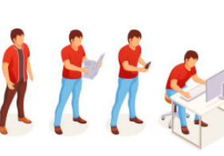
So much has changed with RSHE – what is going on?
SRE has become RSHE!
RSHE became statutory in September 2020
By law schools must provide some relationships and health education to all primary age pupils and some relationships, sex and health education to all secondary age pupils in the remainder of this academic year.
Schools should prioritise RSHE content based on the needs of their pupils, with attention to the importance of positive relationships, as well as mental and physical health.
Notes:
Evolution of SRE to RSHE – discuss.
Statutory Relationships Education, Relationships and Sex Education and Health Education came into effect in September 2020.
Many schools are ready for these requirements, whilst others are still working towards being ready due to the pressures of the pandemic. The DfE has permitted schools to delay teaching until this summer term. The latest statement clarifies expectations of schools in relation to implementing statutory RSHE, by:
Recognising the unique pressures schools are facing this academic year, and the difficulties that they may have in teaching some RSHE content remotely and where it has been possible will have supported pupil mental health during this period.
Reassuring schools they can decide how much of the statutory curriculum can be reasonably achieved this summer term. The law requires schools to provide some relationships and health education to all primary age pupils and some relationships, sex and health education to all secondary age pupils in the remainder of this academic year. Schools should prioritise RSHE content based on the needs of their pupils, with attention to the importance of positive relationships, as well as mental and physical health.
Schools must engage with parents in the RSE policy. This does not need to be in person and can be delivered online.
Permitting schools to use an iterative process, continuing into next academic year, providing time to allow detailed curriculum planning.
Designed to be impactful – for that we must ensure that we design, develop and deliver a curriculum that is responsive to need, not something that we have pulled out of the cupboard (channel 4 living and growing, ‘special cuddle’ etc.
So, let’s identify the need now…

Slide 6

How has this lockdown impacted children/young people?
Notes:
I’m going to role model best practice approaches here and start by identifying need, so we can share this session to respond to this, which is absolutely what we need to do within our individual school communities.
CHAT/Reflect or breakout room?
Real life experiences – what have been the real life experiences?
Online experiences – what have been the online experiences?
What are the safeguarding consequences?
These are the priorities for your school – sleep hygiene, exercise, gaming, finance etc. E-safety // Knowledge, values and interpersonal skills.
Norfolk charity Leeway said lockdown forced victims to spend longer than ever in the confines of an abusive relationship and, for many, cut off their support network. – What does this mean for our children/young people? (ACES – small steps make a big difference)

Slide 7
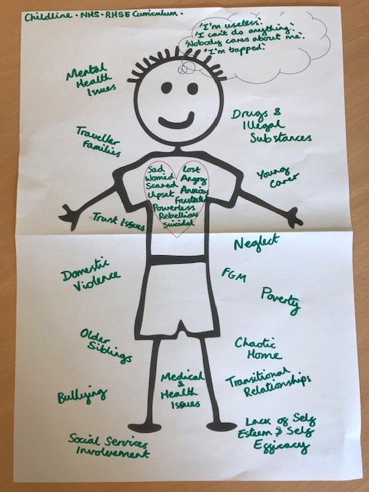
What problems or difficult experiences might someone a year or two older than you be experiencing as a result of Covid-19?
How might these experiences cause them to feel?
What thoughts might they have as a result of these experiences and feelings?
How might these experiences, feelings and thoughts cause someone to behave?
www.schools.norfolk.gov.uk/teachingandlearning/wellbeing-in-education/return-to-school
Notes:
Stick pupil
The Wellbeing Toolkit has some great lesson plans and activities to support with this activity and more!

Slide 8
What children are saying to Childline about coronavirus…
Mental health
Family relationships
School work
Bullying
Reference: NSPCC, What children are saying to Childline about Coronavirus, 2020
Notes:
What do you think are the top concerns that children have contact Childline for during lockdown?
Their report provides an overview of the main concerns that children and young people have been talking to Childline counsellors about during the coronavirus pandemic (COVID-19). Gaining an insight into these worries can help adults think about what support needs to be put in place for young people at this time.
Children and young people who expressed concerns about coronavirus. Issues discussed included:
Mental health
Family relationships
Schoolwork
Bullying

Slide 9
Curriculum
Topic | Statutory Curriculum
Mental health | Simple self-care techniques, including the importance of rest, time spent with friends and family and the benefits of hobbies and interests. Isolation and loneliness can affect children and that it is very important for children to discuss their feelings with an adult and seek support.
Family relationships | How to recognise if family relationships are making them feel unhappy or unsafe, and how to seek help or advice from others if needed.
School work | The importance of sufficient good quality sleep for good health and that a lack of sleep can affect weight, mood and ability to learn.
Bullying | That bullying (including cyberbullying) has a negative and often lasting impact on mental wellbeing.
Notes:
We are now going to take those top 4 topics that were reported in Childline counselling sessions and see where the teaching of the new statutory curriculum can help to address some of these.
It is important to note that the new curriculum is extensive. This is only a snapshot. The new curriculum framework is also a minimum requirement with schools expected to build on this according to identified need.

Slide 10
Teaching RSHE with confidence
Notes:
So… we know we need to teach it, how do we create safe learning environments for this within our classrooms? What about if we have to shut bubbles and still need to teach (legal requirements)

Slide 11
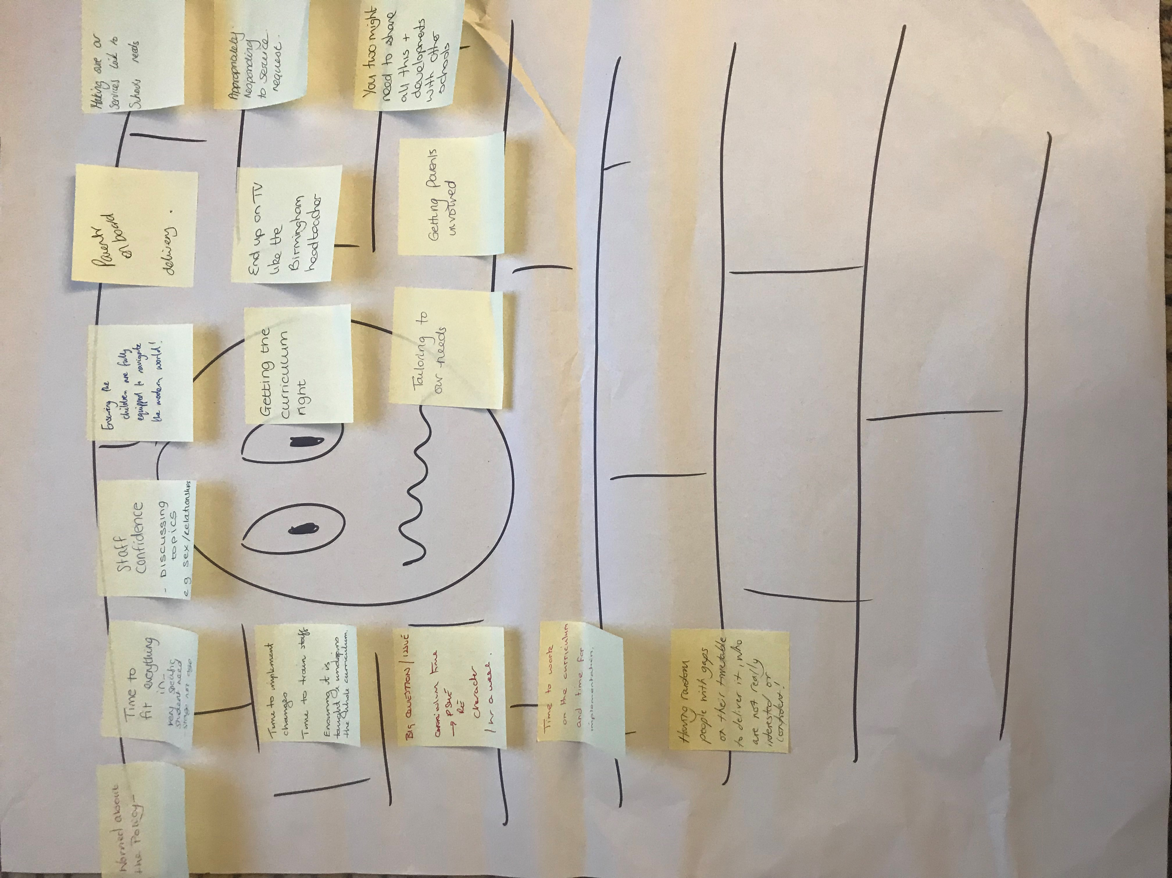
What concerns you most about teaching RSHE?
Getting it ‘wrong’
Parental backlash
Tricky questions
Notes:
Hands up activity
Please put your hand up if you have taught RSHE before? Have you had any formal training to teach RSHE? If so, was this within the last 2 years?
It is no wonder some teachers feel anxious. This is a very different subject to teach and some of our usual teaching and assessment strategies are not appropriate for RSHE. You are not alone: According to the teacher poll, Nationally only 6% of teachers received RSE training as part of their initial teacher training, 29% have never had any training and only 46% say their training was adequate.
High quality, evidence-based and age appropriate teaching of these subjects can prepare pupils for the opportunities, responsibilities and experiences of adult life.
A worry wall is a great way to capture staff concerns about teaching RSHE so you can address these through CPD. Top concerns are commonly sighted as:
Getting it wrong, through not knowing enough to teach some of the topics
A fear of parental backlash – which as we have covered can be addressed through effective parental engagement and a robust RSHE policy
And… tricky questions! In my experience, this one is often the most common concern shared on worry walls.

Slide 12

Creating a safe learning space
Working agreement
Changing the tone of the room
Having a common language
Being able to ask questions
Notes:
Let’s now turn our attention to creating a safe learning environment to teach our pupils in…
In my experience, there are 4 key factors to consider that provide a level of reassurance and familiarity for pupils and teachers alike.
Working agreement
Changing the tone of the room – warm-up/cool down
Having a common language
Being able to ask questions (and for us as teaching being able to control what/how we respond)
We are going to look at asking and answering questions now, but all of the elements and much more are provided in our Staff CPD toolkit.

Slide 13
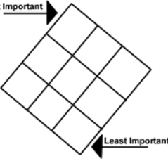
Working agreement
Think before we share
We will listen to each other
I have a right to pass
We will use scientific words. It’s OK not to know them, our teacher will help
We can use our talk cards to ask questions
Notes:
Working agreements provide pupils and teachers with a clear framework for the teaching and learning to take place within.
Keep it positive!
Right/responsibilities
Important that this does not feel like a lesson shrouded in rules!! We need to make sure it is comfortable and engaging so children are well positioned to learn.

Slide 14
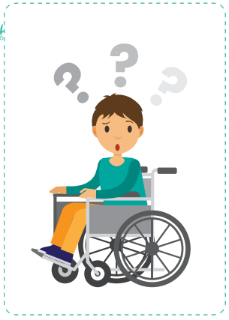

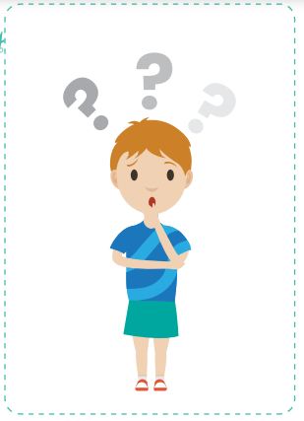
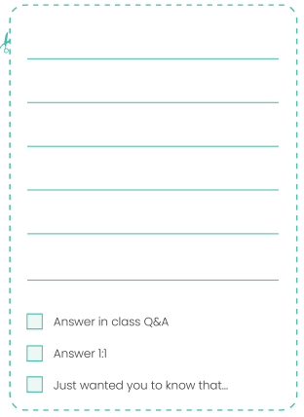
Asking and answering questions
Notes:
There are 2 elements to managing the ‘tricky questions’ fear. The first is pupils to have the confidence to ask their questions and the teacher having a strategy that gives them the confidence they need to answer questions, or not if they are felt age in appropriate.
Talk cards
Ask it basket
Wall of wonder

Slide 15

Ending the lesson
Assessment
Questions
Cooldown
Signposting
Notes:
Ending the lesson is really important from a safeguarding perspective.
There are a number of things to factor into this:
Assessment – checking what has been taught has been learnt
Questions – providing a space for pupils to ask and have their questions answered
Cooldown – setting a different tone for future lessons, especially where topic matter has been challenging
Signposting – so pupils know where and how to access support, including their right to confidentiality

Slide 16
Remote teaching
The same principles apply, but not all topics are appropriate for remote teaching!
Might the topic be difficult for some pupils to discuss or learn about in the home environment?
Will this encourage or make it more likely that a pupil will go onto inappropriate or potentially harmful websites as a result of this lesson/activity?
Might any content cause distress or anxiety to pupils?
Might any content re-traumatise a pupil with personal experience of the topic?
Does the lesson/activity provide sufficient signposting to support currently available to pupils should they wish to discuss the topic further, make a disclosure, or get advice and help?
Notes:
Many teachers will be asked to provide work for pupils to do at home or to teach remotely in the event of school closures due to the coronavirus situation. There is a lot you can do remotely to deliver some aspects of RSHE education.
You have been the remote delivery experts – what approaches could you use to help effective teaching of RSHE in a remote context? (small groups, CHAT, anonymous)
Whether you are teaching face to face or in a virtual classroom, it’s important that you take steps to ensure children are protected. The same principles apply (working agreement, questions, signposting etc.) but some topic areas are not appropriate. Extra consideration to the development of values and skills.
Look at the list of considerations. Once you have reflected on these, what are the topics that you would not be comfortable to teach and why?
The PSHE Association has some great guidance on the topics that they identify as being appropriate to teach remotely (balancing time online, promoting EHWB, online friendships and media, good seep habits etc.), and those which are not (FGM, abusive relationships, specific MH issues). It is important that, particularly with primary pupils, we are mindful what they may do some independent research! Helpful to inform parents in advance, as we would do in more normal times also

Slide 17

Top tips for talking to your child
Schools should also ensure that, when they consult with parents, they provide examples of the resources that they plan to use as this can be reassuring for parents and enables them to continue the conversations started in class at home. This process should include offering parents support in talking to their children about sex education.
Notes:
Let’s think back to our own experience of sex education. For most of us it was likely to have been too little, too late and too biological. This was therefore the experience for many of our parents and so the guidance highlights the need to offer parents support in talking to their children about sex education so they can build on what is being taught at home. This is of increased importance when learning is taking place in the home environment. As schools we teach in an impartial, non-judgemental way so parents have an important role in adding to this with their family values etc. to build up important channels of communication.
You might like to download our fully-funded ‘top tips for talking to your child about tricky things’ information to share with your parents.

Slide 18
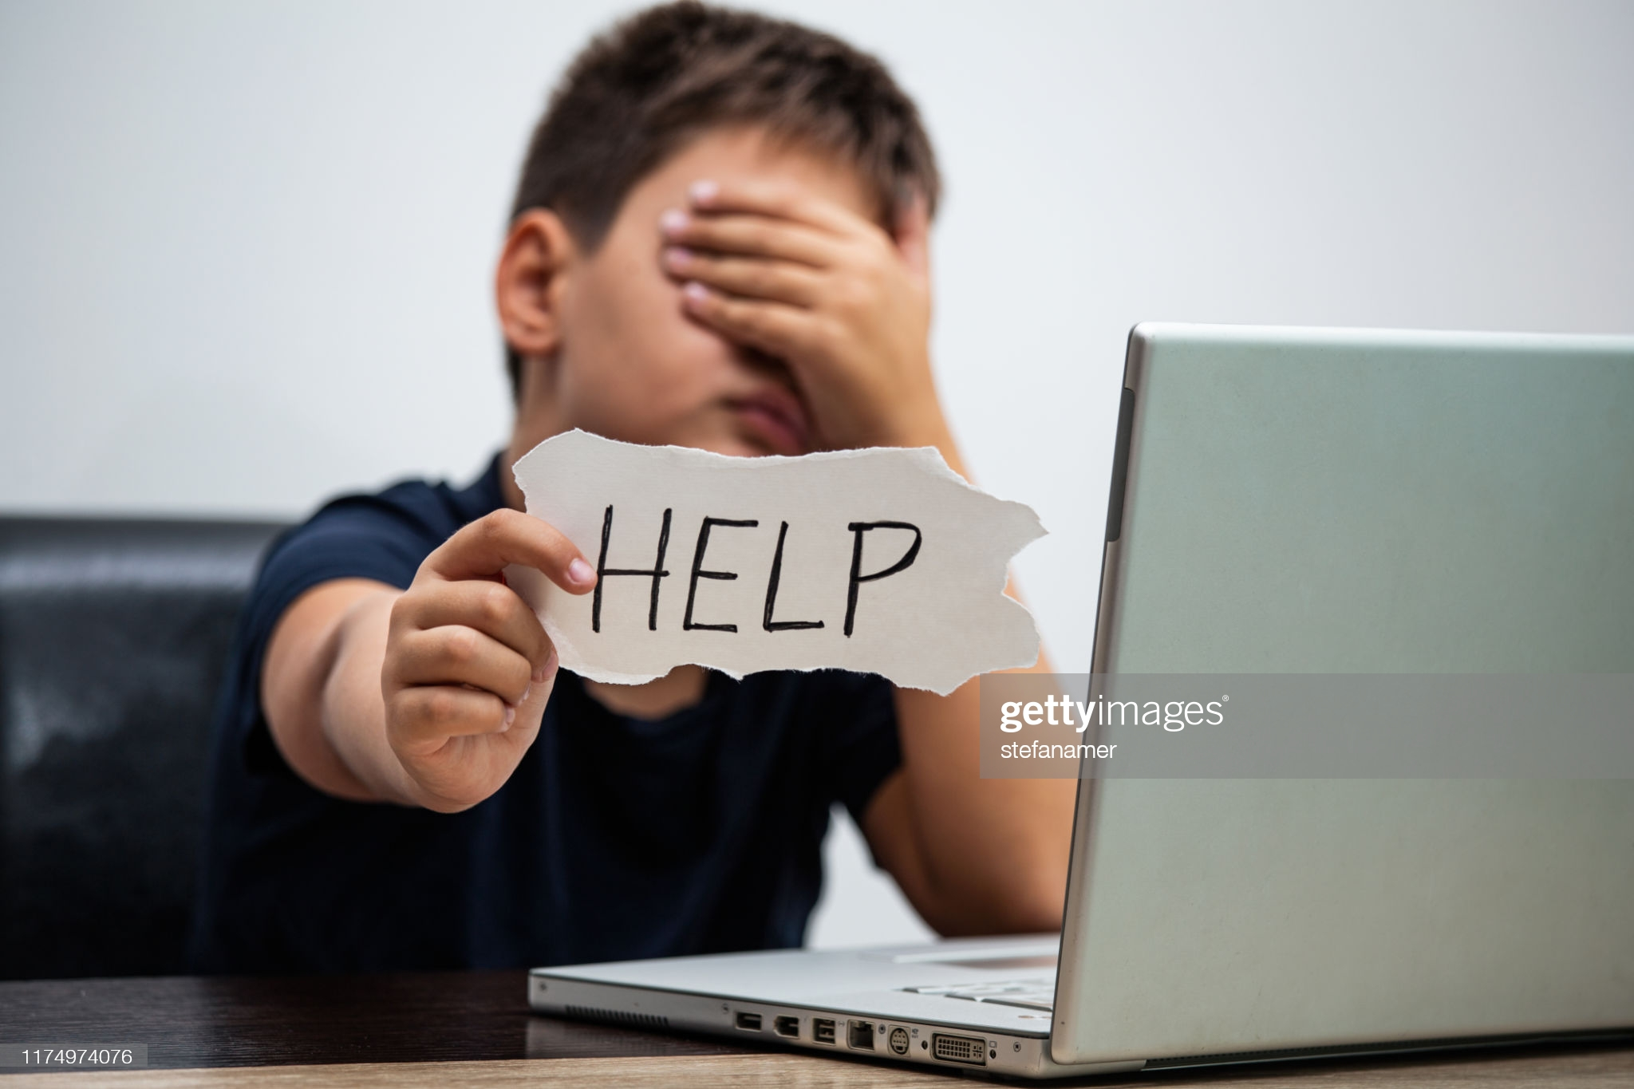
Teaching about asking for help
Knowledge
Values
Skills
Notes:
For me, this is one of the absolute must do priorities. Topic specific content is of course really important, but teaching about asking for help Knowledge – when to, values – that you deserve better and skills – who and how to ask for help and to keep persevering until you get the help you need is transferable no matter what the topic!

Slide 19
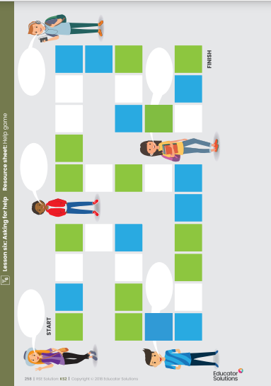
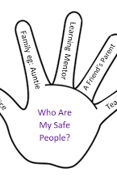
Notes:
There are lots of really creative approaches you can take with pupils, depending on their age and stage.
Helping hands
River of life
RSE Solution resources
Welbeing Toolkit

Slide 20

Questions
Inclusion Helpline: 01603 307736 or inclusionteam@norfolk.gov.uk
Safeguarding: lucy.canning@norfolk.gov.uk
RSHE: reseenquiry@educatorsolutions.org.uk
Wellbeing project: www.schools.norfolk.gov.uk/teachingandlearning/wellbeing-in-education/return-to-school
Notes:
I know that this briefing has covered a lot of ground but not have answered all your questions, and may have raised some additional questions too.
You can email your questions to rseenquiry@educatorsolutions.org.uk
If you have any questions after today, please feel free to contact us.

