Slide 1
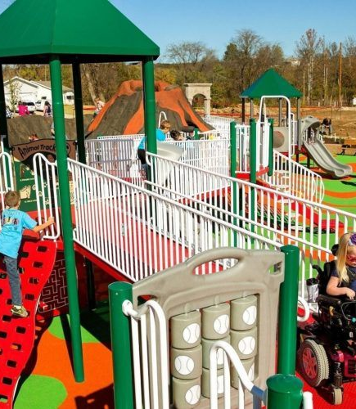
Norfolk Accessibility Strategy for Schools 2019-2021
A summary of the principles of inclusive design

Slide 2
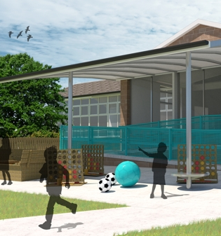
Introduction
Inclusive design enables and empowers disabled people. It ensures that disabled children and adults can participate fully in life in the school community.
The principle of inclusive design should be incorporated into the whole school design – from the buildings and grounds, fixtures, fittings and products within the environment, information and commination technology, the curriculum, teaching and pastoral support.
Inclusive school design goes beyond a one-size-ﬁts-all model and should consider addressing any barriers that might deny anyone the ability to fully participate, whether that be children with SEN, disabled staff or visitors. If the physical environment is designed with accessibility at its heart, it enhances the educational experience for all children no matter what their background or circumstances.

Slide 3
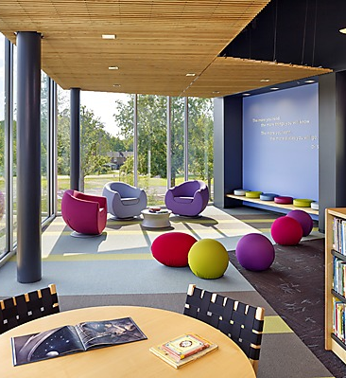
Inclusive design principles
Inclusive – so every child and staff member can access the school environment easily and with dignity.
Responsive – to individual need and what might reasonably be predicted, integrated or offered.
Flexible – so children and staff can work and use facilities and support in different ways that meet their needs.
Realistic – offering more than one solution to help balance everyone’s needs and recognising that one solution may not work for all.
Sustainable – having a school-wide accessibility plan (a statutory requirement under the Equality Act 2010) that sets out what the school is doing to promote accessibility and enables ongoing reflection and improvement on physical and digital accessibility.

Slide 4
What is accessibility?
Accessibility is having the ability to approach, reach, enter, understand, communicate with, or use a service, benefit or the environment (whether the physical or virtual environment) on an equal basis to others.
If this is not possible, adjustments should be made to make something as accessible as possible.
Accessibility questions to consider:
Physical access – how do pupils access and use your buildings, playgrounds, activities, classrooms, lifts and stairs and the physical environment around the school?
Digital inclusion – can pupils learn, play and access information digitally, and in different locations with their class peers in a dignified way?
Accessible information – does the school offer information, reading options and coursework in accessible formats, both digitally and physically?
Policy and decision-making processes – do school and education policies and processes ensure all pupils have the same access to education and opportunities such as extra curriculum activities?

Slide 5
Further information
For further information contact:
Norfolk County Council Equalities Team at
equalities@norfolk.gov.uk
Useful websites
Centre for Accessible Environment offer a range of courses, services and resources around accessibility to the built environment https://cae.org.uk/
Access Association is a national membership organisation that offers access to online resources, e-bulletins and regional meetings that members can access. Cost is around £80 a year. https://www.accessassociation.co.uk/
The Design Council offers a range of online resources and a free e-learning on inclusive design https://www.designcouncil.org.uk/what-we-do/built-environment/inclusive-environments
Making your Digital Environment accessible https://www.gov.uk/service-manual/helping-people-to-use-your-service/making-your-service-accessible-an-introduction

