Slide 1


Welcome, the webinar will start shortly.
Attendance Spotlight Webinar
Delivered by the Attendance Team

Slide 2

Attendance Spotlight Webinar
The School Attendance (Pupil Registration) Regulations 2024

Slide 3

1. What is the statutory definition of a child missing education?
A child who is severely absent from school
A child of statutory school age that is not on a school roll or receiving a suitable education other than at a school
A child on a reduced timetable
All of the above
2. Can you give 3 common reasons a child may become missing from education?
3. How many Norfolk children are registered as CME?
4. How many Norfolk children who are CME have an EHCP?
5. Which scenario describes a legal pupil deletion from a school roll?
Child has stopped attending and parent is refusing to engage with school staff
A new school has been named in a child’s EHCP
A child is medically unfit for school and unlikely to return before the end of Year 11
A mainstream school has received written notification from a parent that they wish to remove their child from the school roll to home educate.

Slide 4
Children at particular risk of missing education
There are many circumstances where a child may become missing from education, so it is vital that the Children Missing Education team are made aware of any child without delay. Although not exhaustive, the list below presents some of the circumstances.
Failure to start school at age 5 and hence never entering the system
Pupils at risk of harm/neglect
Illegal exclusion from school
Withdrawal from school by a parent
Failure to return after school holiday or period of illness
Children of Gypsy, Roma and Traveller (GRT) families
Children of Service Personnel
Missing children and runaways
Children and young people by the Youth Justice Service
Children who cease to attend school
Children of new migrant families

Slide 5
Working Together to Improve School Attendance (2024)
Expectations of Schools
The law requires all schools including independent schools to have an admission register and, except for schools where all pupils are boarders, an attendance register. These registers must be kept electronically. All pupils (regardless of their age) must be placed on the admission register and have their attendance recorded in the attendance register. The proprietor of a school who fails to comply with these regulations is guilty of an offence and can be fined.

Slide 6
Contents of the admission register ‘the school roll’
The school admission register, sometimes known as the ‘the school roll’, must be kept in accordance with the School Attendance (Pupil Registration) (England) Regulations 2024. Regulation 8 sets out the contents of the admission register.
The names of all pupils (both compulsory and non-compulsory school age) must be entered on the admission register.
Schools are expected to use an electronic management information system to keep their attendance and admission registers to improve accuracy, speed up the process of sharing and analysing information, and make returns to local authorities and DfE easier.
Registers are legal records, and all schools must preserve every entry in the attendance or admission register for 6 years from the date the data was entered.
It is vital that the admission register is kept up to date. Schools should encourage parents to inform them of any changes whenever they occur and must ensure the admission register is amended as soon as possible.

Slide 7
Schools Responsibilities
All schools are required to notify the local authority within five days when a pupil’s name is added to the admission register at a non-standard transition point. Schools will need to provide the local authority with all the information held within the admission register about the pupil. Norfolk schools are expected to submit a New Pupil Return.
Schools must notify the local authority when a pupil’s name is to be removed from the admission register at a non-standard transition point under any of the fifteen grounds set out in the regulations, as soon as the ground for removal is met and no later than the time the pupil’s name is removed from the register. In Norfolk schools are expected to submit a Deletion Return Form
The law requires all schools including independent schools to have an admission register and, except for schools where all pupils are boarders, an attendance register. These registers must be kept electronically. All pupils (regardless of their age) must be placed on the admission register and have their attendance recorded in the attendance register. The proprietor of a school who fails to comply with these regulations is guilty of an offence and can be fined.

Slide 8
Deletion returns
A | Pupil is registered at another school
B | Pupil was enrolled in Nursery but not enrolled into Year R
C | Ceasing of dual registration
D | A school attendance order relating to the pupil and formerly naming the school has been amended by the relevant local authority to substitute the name of the school with that of another school
E | A school attendance order relating to the pupil and naming the school has been revoked by the relevant local authority on the ground that arrangements have been made for the pupil to receive suitable education otherwise than at school
F | Elective home education
G | Pupil has moved ceased to attend and the new address is beyond reasonable distance from registered school
H | Pupil has failed to return within 10 days of expected return from agreed leave of absence
I | Pupil’s whereabouts are unknown
J | Pupil is in custody
K | Pupil is deceased
L | Pupil will cease to be of compulsory school age before start of next academic year
M | Pupil is a boarder, and fees remain outstanding at end of school term to which they apply
N | Pupil’s name has been removed from roll of independent school
O | Permanent exclusion and appeal process has complete
* | End of school phase and pupil is not transferring via NCC admissions arranged school place (Yr2 state funded infant schools Yr6 state funded junior and primary schools)
All schools must make a return to the local authority when a pupil’s name is deleted from the admission register (a Deletion Return).
A pupil’s name can only be deleted from the admission register for a reason set out in regulation 9 of the School Attendance (Pupil Registration) (England) Regulations 2024.
Schools cannot retrospectively delete a pupil’s name from the admission register or attendance register.

Slide 9
What happens if a parent does not accept the school place offered?
The Admissions Team and CME Team will work with parent to gain an understanding of why the parent does not want to accept the place.
If this is the only offer the LA can make, the parent will be made aware of their options. They can appeal the decision via appeals process, or the LA will look to initiate the School Attendance Order process.
The school that has been offered will be named in a School Attendance Order. Parents could be prosecuted if they are found to be in breach of an order.

Slide 10
School Attendance Order (SAO)
If a local authority is not satisfied that the parents are providing a suitable education to a child of compulsory school age and it is appropriate for the child to attend school, they can apply for a School Attendance Order under Section 437(3) Education Act 1996.
The order will require the child's parents to register the child at a named school. Failure to comply with a School Attendance Order amounts to an offence which the parent can be prosecuted for

Slide 11
When would a School Attendance Order be considered?
There will be three different scenarios when a SAO may need to be considered.
Parent(s) submitted an application for school place but refuses to accept the place offered by Admissions team/Fair Access team
Parent does not agree with school named in an EHCP
If it appears to a local authority that a child of compulsory school age in their area is not receiving suitable education, either by regular attendance at school or otherwise, they shall serve a notice in writing on the parent requiring him to satisfy them within the period specified in the notice that the child is receiving such education.

Slide 12
Identifying a school to be named in a School Attendance Order
In Norfolk, the Admissions Team Manager is responsible for ensuring that the naming of the school is compliant with legislation and statutory guidance i.e., it must be the school named in any Education, Health Care Plan the child holds, otherwise, the catchment, or nearest local school will be named.
Particularly relevant for any previously permanently excluded children, the Local Authority, will look to name UET Pathfinder Academy.
If there are known exceptional circumstances why naming the catchment school, or nearest school, would not be in the child’s best interest the next nearest school will be named by the Admissions Team.
In cases where a place was offered via Admissions/Fair Access team or named in EHCP, the school allocated/named will be the school to be named in the SAO.

Slide 13
SAO Formal Consultation
Once a school has been identified by the LA, the allocated Attendance and Entitlement Officer (AEO) must hold a formal consultation with the Head Teacher and Chair of Governors/Member of the Trust as this is a statutory requirement.
It is essential to ensure that those present have responsibility for the school’s admission arrangements.
At the formal consultation the AEO will advise the school of the information and history known for the child and the School Attendance Order process.
If the School representatives do not agree for the school to be named for the child, the AEO will inform the Senior Children Missing Education Officer. The school will be asked to provide in writing within 7 days their reasoning for not being named and why this would not be in the child’s best interest.
A panel will be convened with attendance by the Attendance and Entitlement Manager, Senior Children Missing Education Officer, Admissions Manager, and the Fair Access Manager. The panel will consider the case and the school’s rationale for not being named in the Order.
If the panel agree with the school’s rationale, then an alternative school will be identified for the AEO to consult with.
If the panel do not agree with the school’s rationale the school will be invited to share their reasons for refusal at the next Fair Access Panel. A decision will be made by panel members regarding the most appropriate school to be named in the SAO.

Slide 14
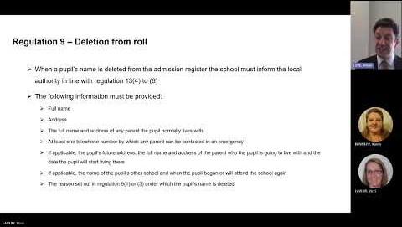
School admission register: deletion from the school roll
This webinar an overview of requirements for keeping a school’s admission register (sometimes also known as the school roll) and changes to 2 grounds for deletion in the School Attendance (Pupil Registration)(England) Regulations 2024.
School admission register: deletion from the school roll

Slide 15
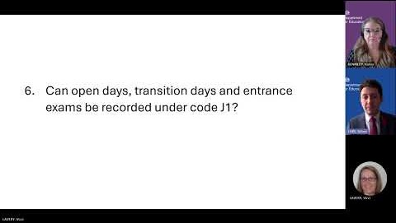
FAQ – School attendance and admission registers
This webinar provides answers to the questions that have been most frequently asked in the first half of the Autumn Term. Providing help for using the attendance and absence codes that are now mandatory, in line with the School Attendance (Pupil Registration)(England) Regulations 2024.
FAQ – School attendance and admission registers

Slide 16

Attendance News & Current Events

Slide 17

Implementing the National Framework for Attendance – November 2024
We consulted with schools at the beginning of the Summer Term 2024 to inform our response to the introduction of the new national framework for school attendance. We received 104 responses which indicated that, in general, schools felt confident about implementing the requirements of the reforms and we used the results inform the development of guidance and support for schools. Now that the reforms are statutory, we would like to take this opportunity to understand how confident schools feel and identify any additional support needs they may have.
Link to survey – Implementing the National Framework for Attendance

Slide 18

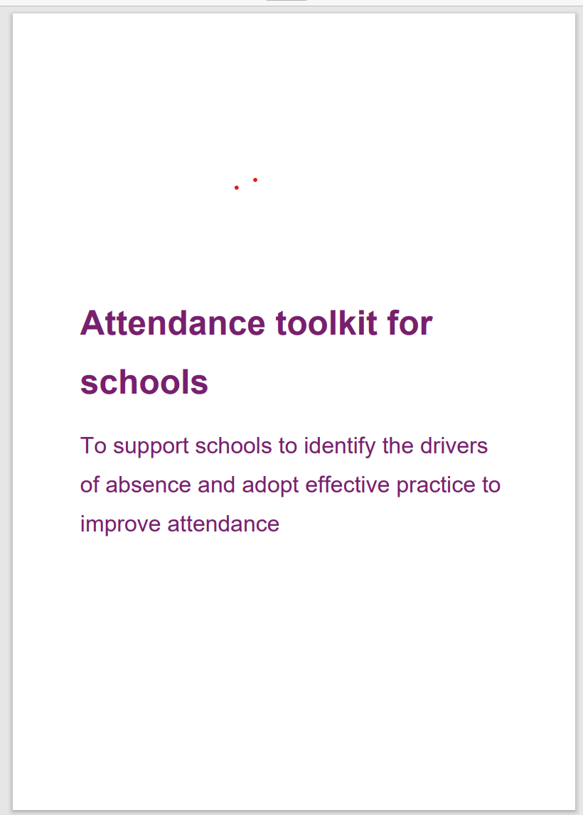




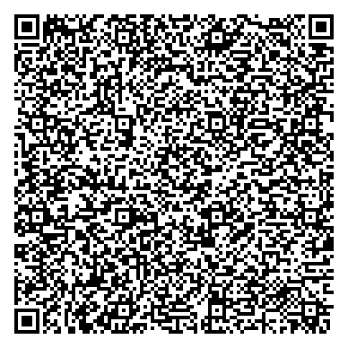

Toolkit |  | Attendance toolkit for schools: six key areas
A toolkit of adoptable practice to support improvement
Data and targeted support
how to gather, share and use attendance data to put in place action to improve attendance.
Culture
how to embed a support-first culture to encourage high attendance and make school a place children want to attend.
People
how to make attendance ‘everyone’s business’ and ensure individuals and teams work together to reduce absence.
Processes and systems
how to develop and implement strong and rigorous processes to identify and respond quickly and effectively to absence
Relationships
how to build strong and positive relationships with pupils and families to understand, then prevent or remove barriers to attendance.
Communications
how to develop and share strong and inclusive attendance communications that convey messages with impact.
Notes:
Schools can now access an attendance toolkit developed in collaboration with Rob Tarn, National Attendance Ambassador, and attendance hub leads. It helps schools identify drivers of absence and adopt effective practice to improve attendance. It provides practical resources across six areas; data and targeted support, culture, people, processes and systems, relationships and communications.

Slide 19



Data sharing & absence returns
In line with The Education (Information About Individual Pupils) (England) (Amendment) Regulations 2024 and the requirements of 'Working together to improve school attendance', all schools are now legally required to share information from their registers with the DfE and the local authority.
Sharing data with the DfE:
From the start of the 2024-25 academic year, schools have a duty to provide attendance information to the Department for Education (DfE) on request. Data indicates that as of 6th September, over 380 have already signed up to share their daily attendance data with the DfE in line with statutory requirements.
Action: It is important that all schools ensure that they have completed this process and for those schools who have not, further guidance on how to share your data is available via this link: Share your daily school attendance data - GOV.UK (www.gov.uk)
Once you are sharing data with the DfE you will have access to a range of tools that will support you to analyse your data. The DfE has published guidance for schools, academy trusts and local authorities on using the monitor your school attendance tool.
Sharing data with the LA:
Further, to facilitate timely collaborative working across partners, all schools are also required to share information from their registers with the local authority. As a minimum this includes:
New Pupil and Deletion returns
Attendance returns
Sickness returns
If your school is not currently sharing data as part of the local arrangements, you will receive an e-mail from attendancedatacollection@norfolk.gov.uk within the next two weeks providing guidance on what you need to do next.
If you already provide attendance data to the LA via the local arrangements, please also contact attendancedatacollection@norfolk.gov.uk if:
You have changed Management Information System provider over the Summer as this will impact on data collection.
You are unsure of who we hold as your contact for the local data feed and/or would like to make a change to the contact.
Notes:
As an LA, we want to reduce the administrative burden placed on schools as well as support them to meet with national requirements. As a result, we need schools to engage with both our local attendance data arrangements as well as the DfE collection of attendance data. This is because the DfE does not currently provide the facility to export data relating to sessional attendance codes which are required for the purpose of the sickness and attendance returns. As the DfE systems develop, we envisage that we will be able to cease the local collection of data and are providing feedback on proposed future development of the national system. Engaging with both systems simultaneously will not add to schools workloads nor compromise information security.

Slide 20
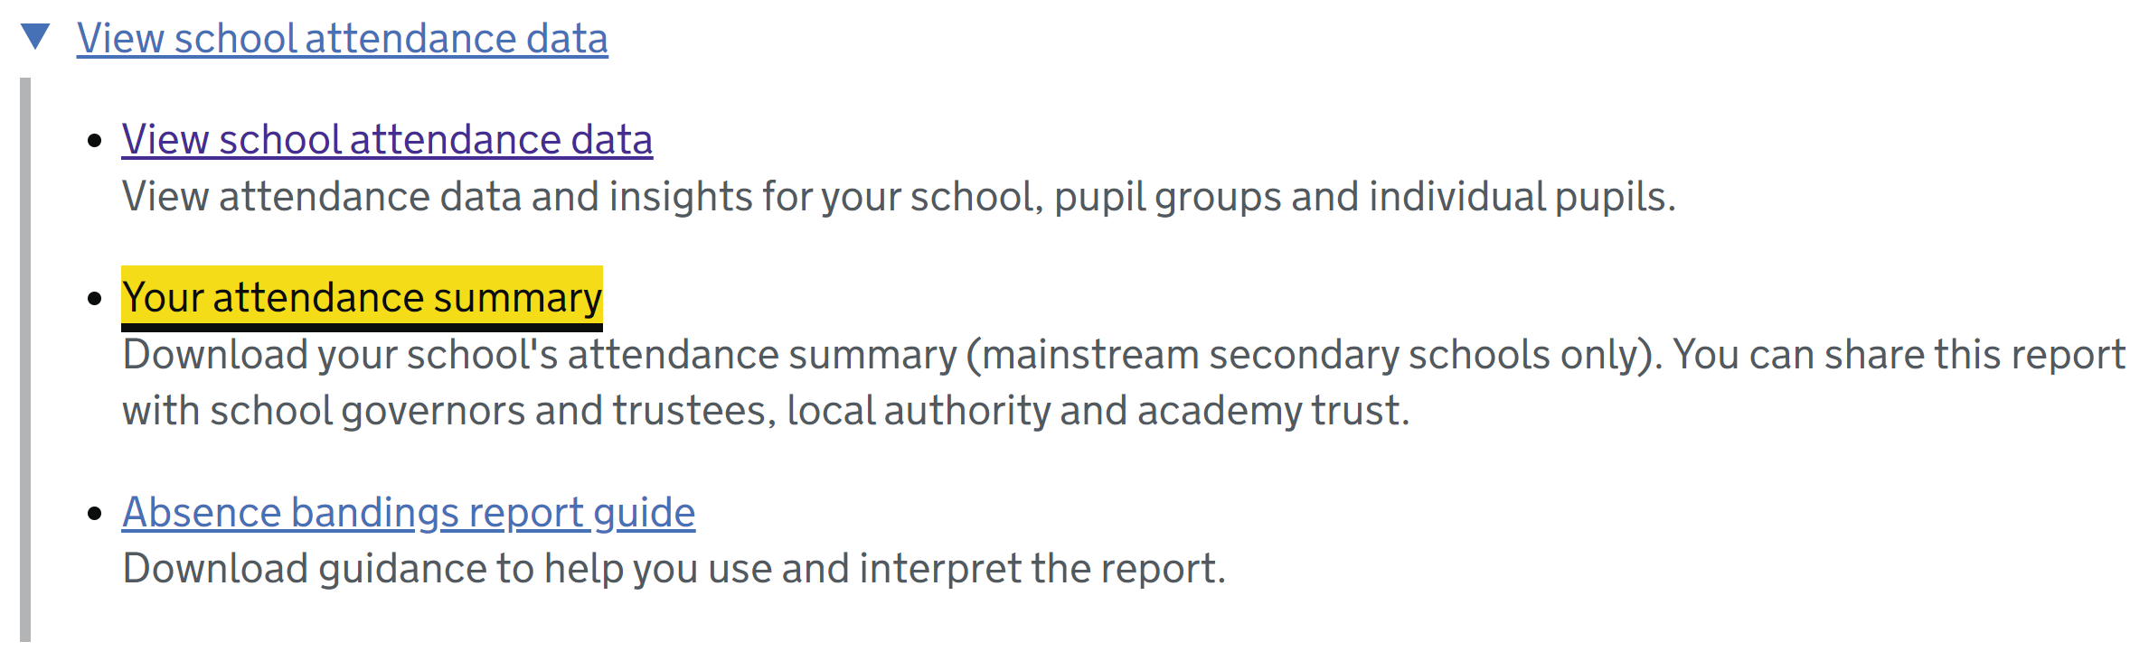
20

Slide 21

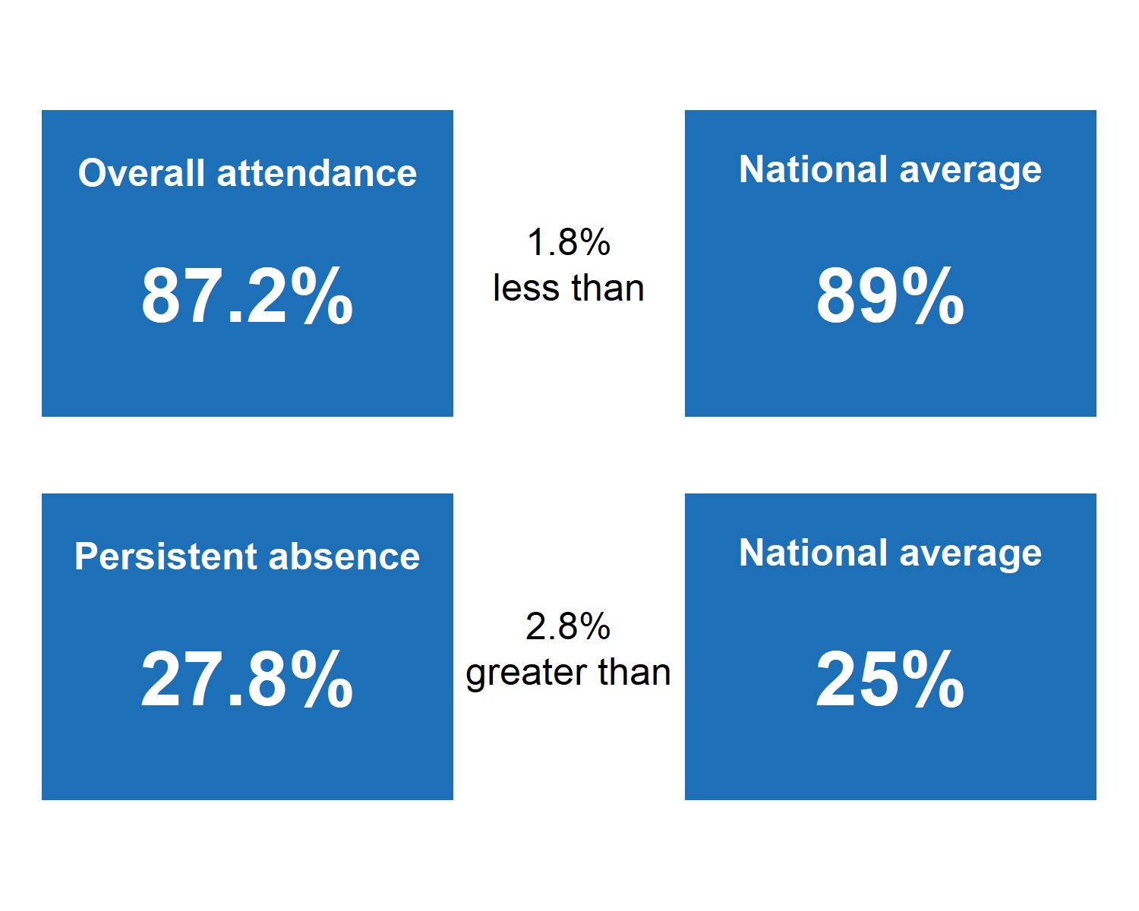
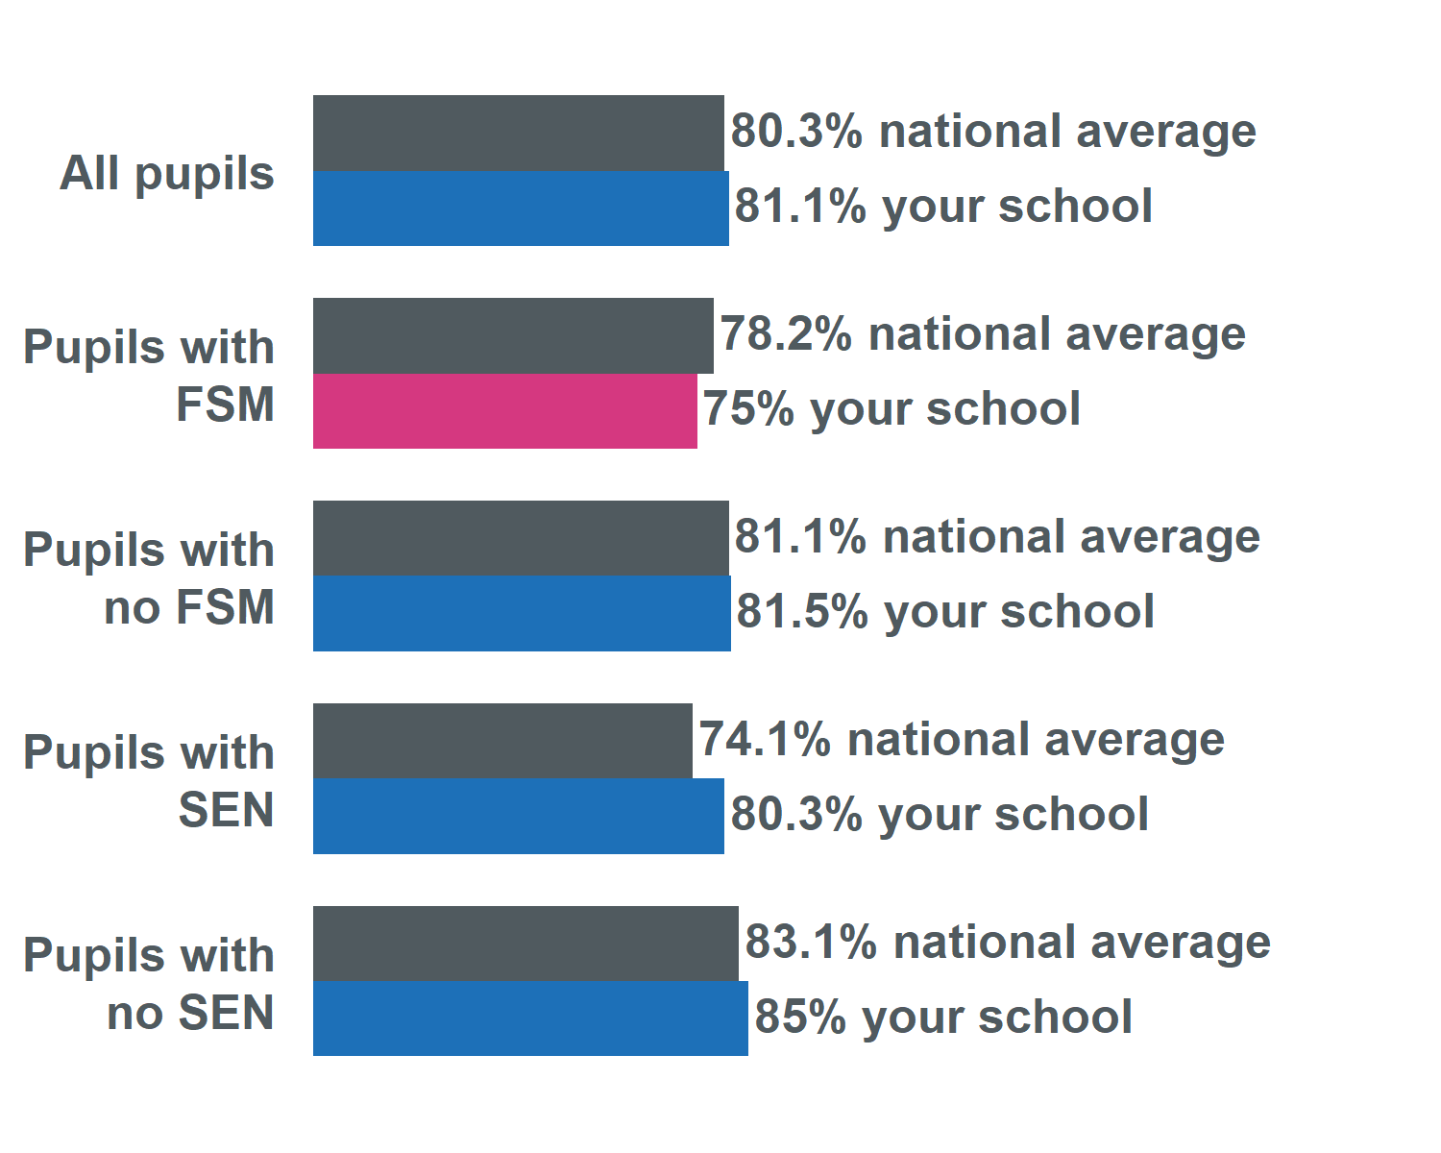
Your Attendance Summary report
Reports will be distributed half-termly and contain:
Comparisons of your school’s overall attendance and persistent absence with the national average, both overall and split by FSM eligibility and SEN status
Specimen content – all figures indicative only

Slide 22

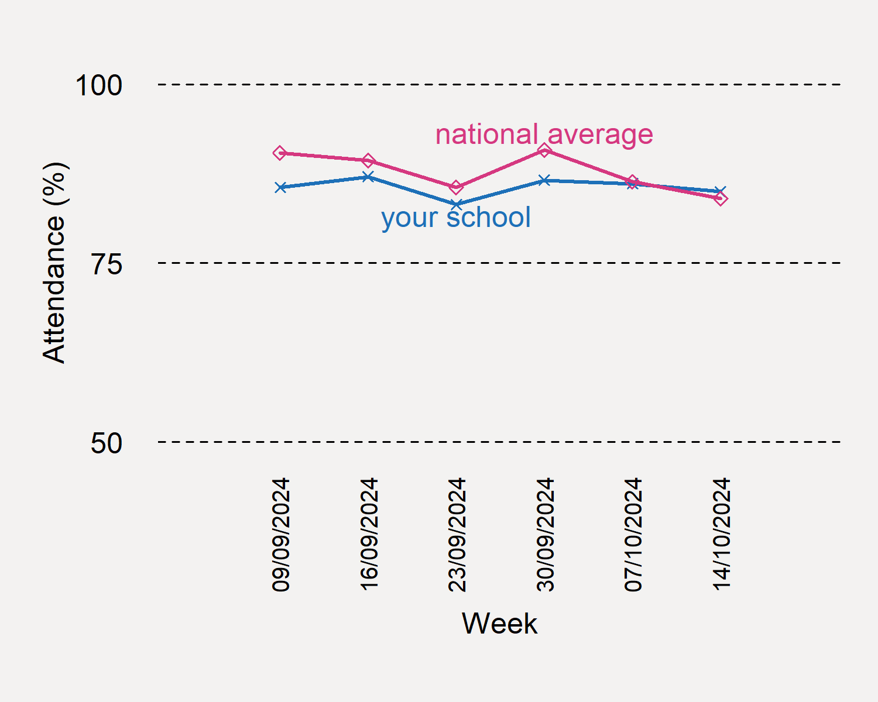
Your Attendance Summary report
Reports will be distributed half-termly and contain:
A week-by-week comparison between your school’s overall attendance and the weekly national average
Specimen content – all figures indicative only

Slide 23

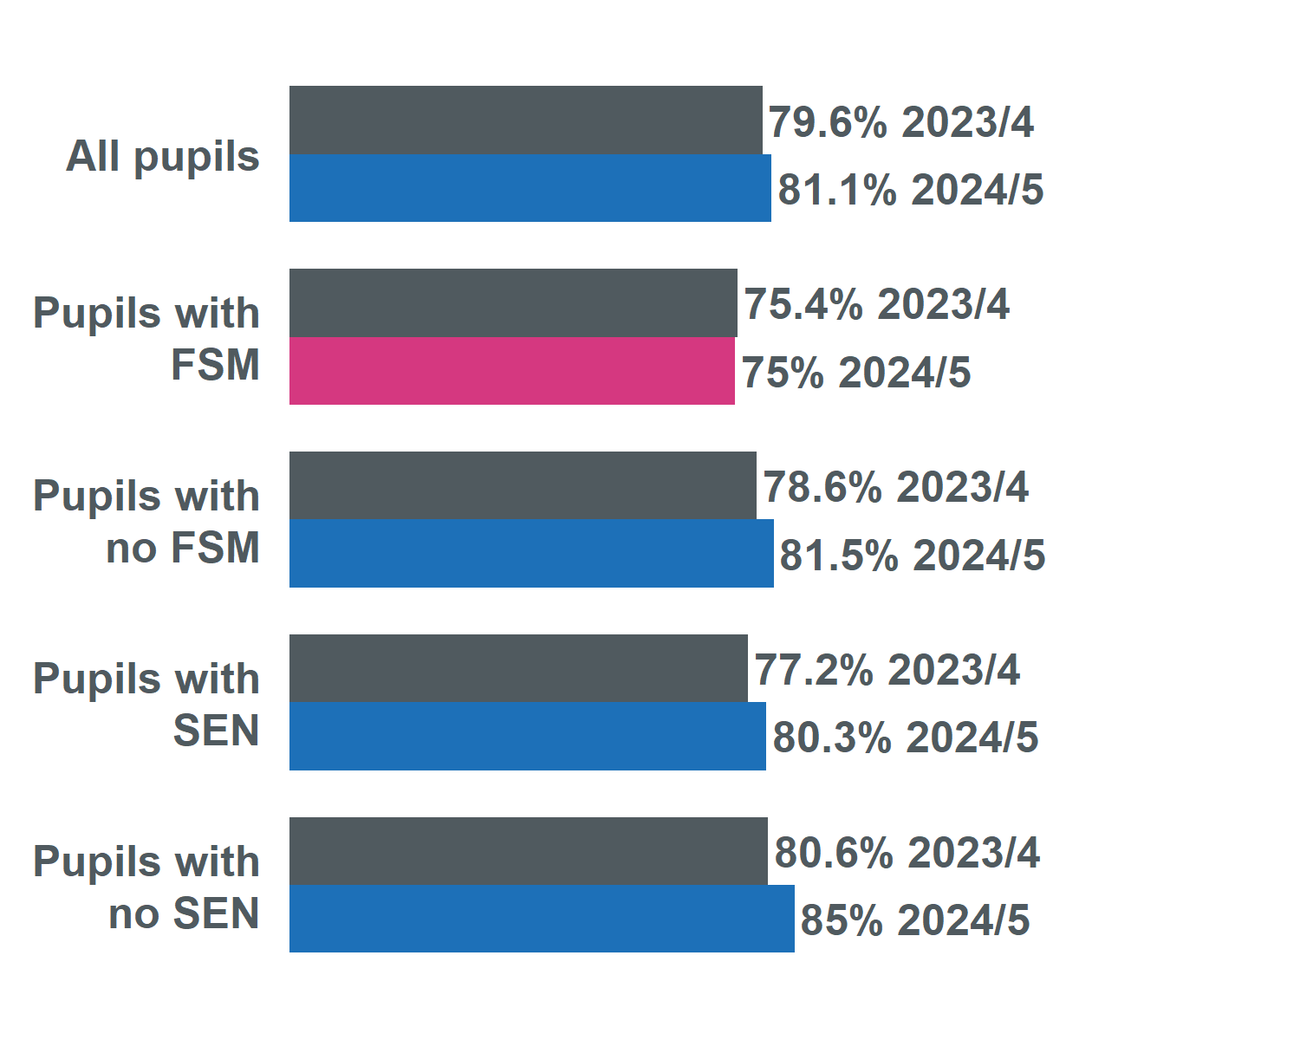
Your Attendance Summary report
Reports will be distributed half-termly and contain:
Comparison of your school’s overall attendance with the same period in the previous academic year, both overall and split by FSM eligibility and SEN status
Specimen content – all figures indicative only

Slide 24

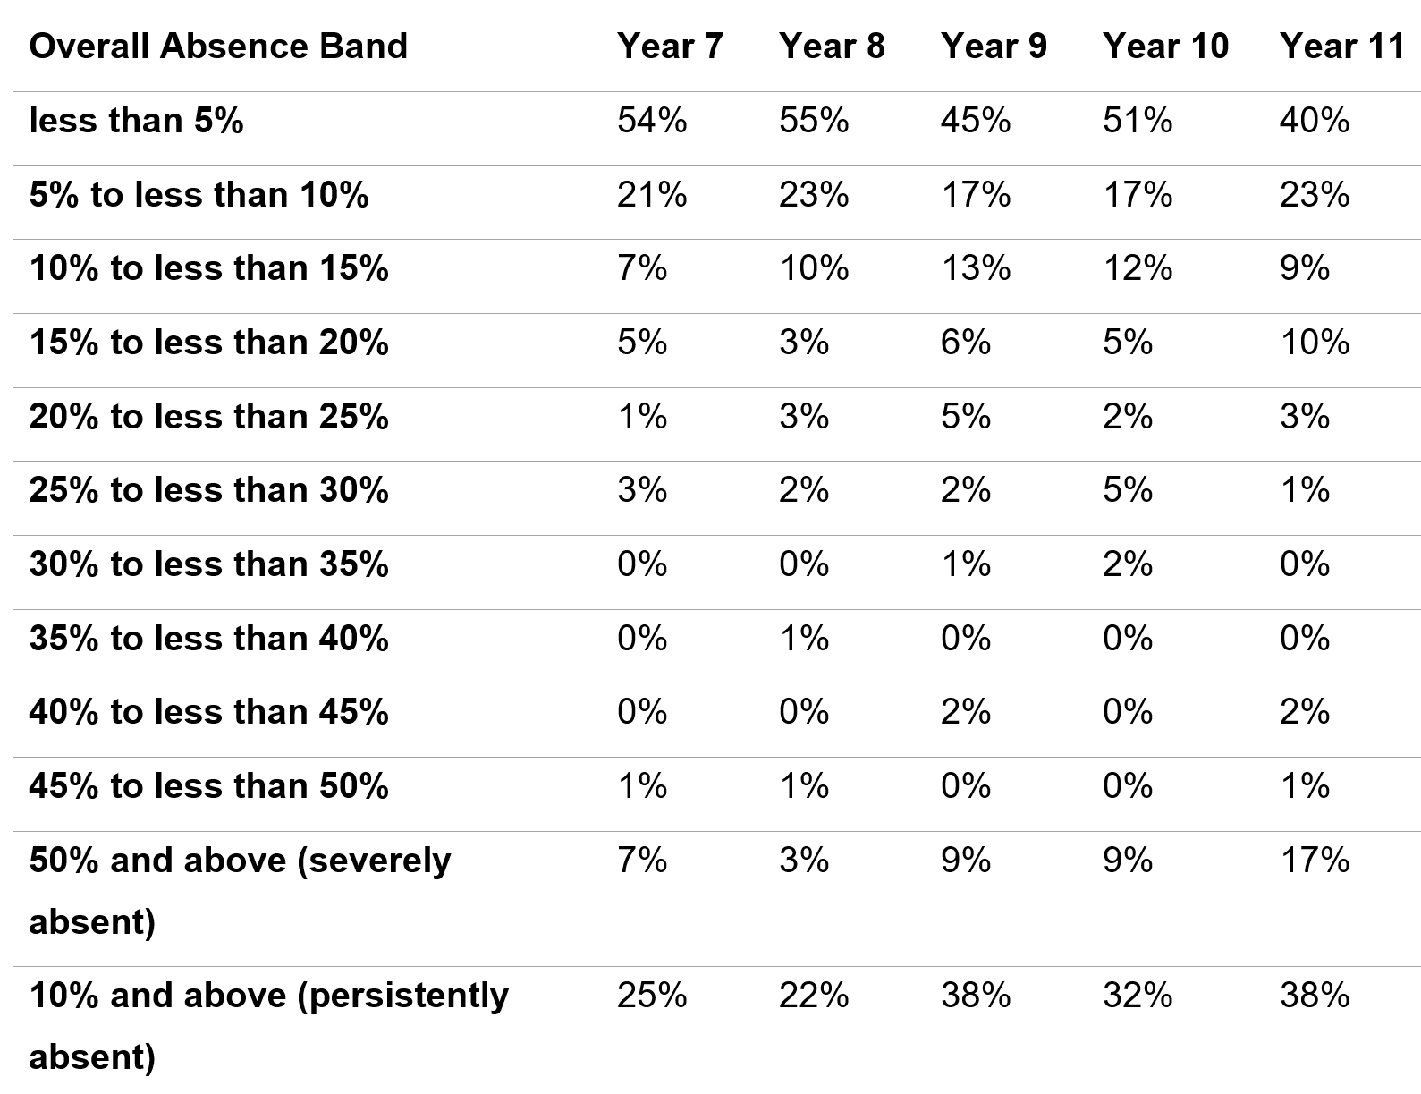
Your Attendance Summary report
Reports will be distributed half-termly and contain:
Absence banding table split by year group
Specimen content – all figures indicative only

Slide 25


How can I use my Attendance Summary report?
Share it with governors, your local authority and academy trust as part of conversations on how to improve attendance
Identify areas to dive further into using other tools in View Your Education Data (the reports contain instructions for how to investigate further)

Slide 26
Targeting Support Meetings
Schools are expected to participate in these meetings in line with 'Working together to improve school attendance.' The number of meetings a school is expected to have is outlined within the DfE guidance and depends on the level of the attendance challenges in the school:
If your school's attendance levels were below the national average for your phase, it is expected that you book a TSM for each term
If your school's attendance levels were above national average for that phase, you may if you want only schedule one TSM for the academic year.
We would encourage all secondary schools in Norfolk to book a TSM for each term, whether above or below national average. If your setting's attendance rates are above the national average for your phase and you wish to meet with us termly, you are welcome and invited to do so.
Booking your TSM
To book your TSMs for the academic year:
Visit the following page: NCC Targeting Support Meeting Bookings
Select the meeting type that applies to your school setting.
Select the date you wish to book in the calendar.
Select a time from the available options.
Add your details into the required fields, ensuring to include the name of your school.
Select book and you will receive an email confirmation of your booking.
Please note:
If you wish other colleagues to attend, you can forward the meeting invitation.
When booking a meeting for each term, you will need to repeat this process for each booking.
If a date or time is unavailable that is because the slot is already booked, or the date falls outside of term-time based on the Norfolk calendar.
Notes:
Targeting Support Meetings (TSMs) are essential for early identification and support of pupils with habitual attendance issues, requiring collaboration between schools, local authorities, and partners. Local authorities are expected to organise these meetings regularly with each school to build strong relationships, discuss overall trends and emerging trends in the school's attendance data, identify and agree on action plans for severely absent pupils, and discuss approaches for persistently absent pupils needing multi-agency responses.

Slide 27


Save the date!
Attendance Spotlight Webinars
Will be held approximately on the last Thursday of each month. They will begin at 10.30am and can be accessed via the links in the Upcoming events section of Attendance news and events page. Autumn Term schedule:
19th December 2024
23rd January 2025
6th February 2025
27th March 205
24th April 2025
22nd May 2025
3rd July 2025
Countywide Attendance Network Meetings
Spring Network Meeting: Thursday 27th February
Summer Network Meeting: Thursday 26th June
All held in person at The Inspiration Teaching Hub.
Keep up to date with Attendance news and events via:
Attendance news and events page
And by registering to receive weekly emails and updates from the News for Norfolk Education Providers.
Webpage for News for Norfolk Education Providers can be found here.

Slide 28

Further support and guidance can be found at:
School attendance - Schools (norfolk.gov.uk)
If you have any further questions that have not been answered today, then please contact the Attendance Team on 01603 233681 or at csattendance@norfolk.gov.uk

