Slide 1


Welcome, the webinar will start shortly.
Attendance Spotlight Webinar
Delivered by the Attendance Team

Slide 2

Attendance Spotlight Webinar
STEPS

Slide 3

Norfolk Steps Overview Session
19.12.24

Slide 4
What is Norfolk Steps?

Slide 5
Our Steps Core Values
All behaviours are communicative.
Understanding the needs, experiences, feelings, and what makes the CYP an individual can shape consistent, inclusive support plans.
Staff and CYP relationships, underpinned by positive interactions and trust, are pivotal for positive outcomes.
Staff must use proactive responses whenever they can and reactive responses only when reasonable, proportionate and necessary.
All responses must be supportive including those that manage behaviours that challenge or harm.
All actions taken to manage behaviours that challenge or harm must be in the best interests of the CYP, considering their individual needs.

Slide 6

Flourish and Norfolk Steps
Steps Principles:
Consistency is key
Everyone is responsible for promoting positive behaviours
Positive language is prioritised
Positive relationships are vital
Behaviours are communication
Family and friends
Access to learning
The opportunity to lead a good life
Being understood
Building resilience
Respect for their individuality
Feeling safe
Being healthy

Slide 7
Step On
Promoting positive behaviours through:
Whole school culture and ethos
Consistency
Planning
Exploring functions of behaviour
Meeting unmet need
Building relationships

Slide 8
Step On
Can be self directed digital learning for modules 1-7.
Module 8 – physical intervention must be led by a Step On Lead Professional.
Can also be trained as a whole group by the school’s Lead Professional using the digital modules and the additional learning gained through Step On LP training.
The LP training is 2 days and covers content in the digital modules and Module 8.

Slide 9
Module | Aims | Module length | Approx activity time​ | Approx total time
Module 1 – Getting to Grips with the Guidance | Understand key guidance and legislation, including how this relates to our roles in schools | 25 minutes​ | 20 minutes​ | 45 minutes​
Module 2 – Whole School Culture and Ethos | Understand the importance of a positive whole school culture and ethos in relation to wellbeing and behaviour Know how to use the Steps principles to promote a positive whole school culture and ethos | 25 minutes​ | 10 minutes​ | 35 minutes​
Module 3 – Identifying what Underpins Behaviour | Recognise responses to behaviours Explore factors which may underpin behaviours Understand pupil needs | 25 minutes​ | 20 minutes​ | 45 minutes ​
Module 4 – Planning for Positive Behaviour | Explore the concept of inclusion Understand behaviour analysis and planning tools Recognise the importance of consistency between home and school | 30 minutes​ | 45 minutes​ | 1 hour 15 minutes​
Module 5 – Crisis Cycle: Introduction | Explore the link between the brain and behaviour Consider how behaviours can be understood through the crisis cycle | 10 minutes​ | 0​ | 10 minutes​
Module 6 – Crisis Cycle: Baseline, Escalation and Crisis Point | Identify how to support behaviour at different stages of escalation Continue to develop a positive behaviour support plan | 30 minutes​ | 45 minutes​ | 1 hour 15 minutes​
Module 7 – Crisis Cycle: De-escalation and Debrief | Identify how to support behaviour at different stages of de-escalation Understand the importance of reflection, reparation, and restoration Confidently complete a positive behaviour support plan Explore how to make the plans more accessible to staff | 30 minutes​ | 25 minutes​ | 55 minutes​
Module 8 – An Introduction to Physical Intervention | Understand legislation and guidance relevant to physical intervention Recognise safe Step On physical intervention techniques Consider the continuum of physical intervention techniques and when they are appropriate to use Know what actions to take following the use of physical intervention | 35 minutes​ | 1 hour 30 minutes​ | 2 hours 5 minutes​ (dependent on prior experience and number of colleagues)
Total: 7 hours 45 mins
Securing Successful Steps Strategies in School (only SLP) | Understand the Step On e-learning content and flexible approaches to delivery Review current practice in your school to identify areas of strength and priority areas for development Understand how to support your school to consistently embed Steps approaches | 15 minutes | 0 | 15 minutes

Slide 10
Functions of Behaviour
All behaviour is communication. The behaviour itself can be positive, negative or apathetic. Our role as professionals when understanding behaviour that challenges us, is to decipher what the CYP is trying to tell us.
We need to know the function of their behaviour.
Sensory | Tangible | Escape | Attention / Connection
Hyper or hypo arousal can lead to people engaging in behaviour to help them manage sensory input from their environments. This can be closely linked to ‘escape’ behaviours. May also include hunger, thirst etc | To gain a desired object, activity or experience. | To avoid an overwhelming activity, experience or sensory trigger. This also covers avoiding demands and managing accumulated stress. | To gain attention from, or connection with, another person or people. This attention could be positive or negative and be from someone specific or anyone available.
*

Slide 11

Functions of Behaviour
ESCAPE | ATTENTION / CONNECTION
Refusal to engage in work Pushing work away or destroying books and resources Avoiding sitting at desk or workstation by walking around Hiding (in classroom or elsewhere) Exiting lessons or presenting in a way that is reinforced by this Absconding / running away (not looking to see if they are followed) Hands over ears, eyes closed, head down on desk Reluctant to go to a specific place Reluctance to return to an environment (lateness, truancy) | Need to seek out support from staff often – won’t attempt a task without an adult present Talking to peers, including at inappropriate times e.g. during teacher input Low-level disruptive behaviours e.g. tapping, fidgeting, calling out Disengagement with learning – struggles to overcome challenges and gives up easily Appears defiant, hard to motivate, requires lots of engagement from staff to focus Makes eye contact with staff when running away Persistently seeking physical touch and being overly close Frequently reporting perceived or actual injuries and/or illness (if actual it can also be linked to a need to escape the ‘pain’ whether physical or psychological)

Slide 12
Functions of Behaviour
SENSORY | TANGIBLE
Unable to sit still – often walking around the room at inappropriate times Fidgety whilst sitting; changing position Tapping, doodling, fiddling with objects on the table Rocking back and forth on a chair Covering ears and closing eyes – attempting to shut out sensory input Chewing, spitting and dribbling | Attempts to gain access to a specific object or activity Shouting demands Frustration; shown by swearing, throwing objects or damaging own or others’ items Hurting others to gain access to an item / object Difficulties around sharing Perceived or actual lack of having objects at home (taking items home)

Slide 13
Proactive Strategies
More examples of supportive strategies can be found on the padlet
The functions of behaviour tell us about the CYP unmet needs.
Once you have identified the function of the behaviour, you are better able to support the CYP proactively to meet these needs in a positive way to avoid escalating low-level challenges into a crisis.
Sensory | Tangible | Escape | Attention / Connection
Sensory Diet Allow the CYP regular, planned opportunities to meet their sensory needs (some may also need ad-hoc opportunities). | Positive, reward-based behaviour strategies Using a reward-based system may motivate CYP when they are not intrinsically driven. Rewards must be regular and achievable. | Allow safe and structured opportunities to exit overwhelming situations E.g. ‘break out’ card for use in lessons, adjust timetable if appropriate, quiet / safe spaces for meals and unstructured times. | Avoid ‘planned ignoring’ Notice the low-level behaviour early and meet the need e.g. by asking them to help you with a job, distraction / redirection.

Slide 14
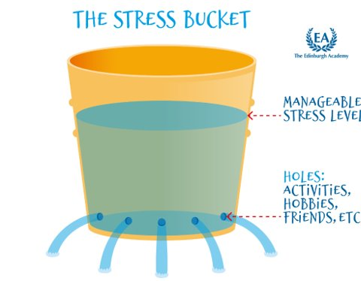
Stress Bucket
Notes:
The stress bucket can be useful to help understand how some children may become overwhelmed by a build up of stressors. CYP who have had traumatic experiences may have smaller buckets, which can lead to their buckets ‘over-flowing’ much more quickly. We can help alleviate these stressors through planning and providing positive experiences.

Slide 15


Roots and fruits
behaviour
feelings
experiences
*
Notes:
This diagram emphasises the link between experiences, feelings and behaviour.

Slide 16
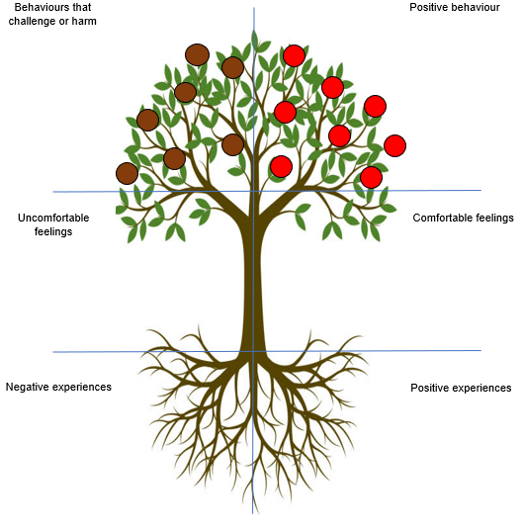
Roots and fruits
Think of a CYP who is currently struggling with their behaviour and complete the ‘roots & fruits’ analysis.
Notes:
This can be presented as a generic version – colleagues can discuss and complete
You may wish to present this as an activity around specific children. Staff can be grouped to do this. Ensure you have a copy of a blank plan available for ech of the CYP being discussed.

Slide 17
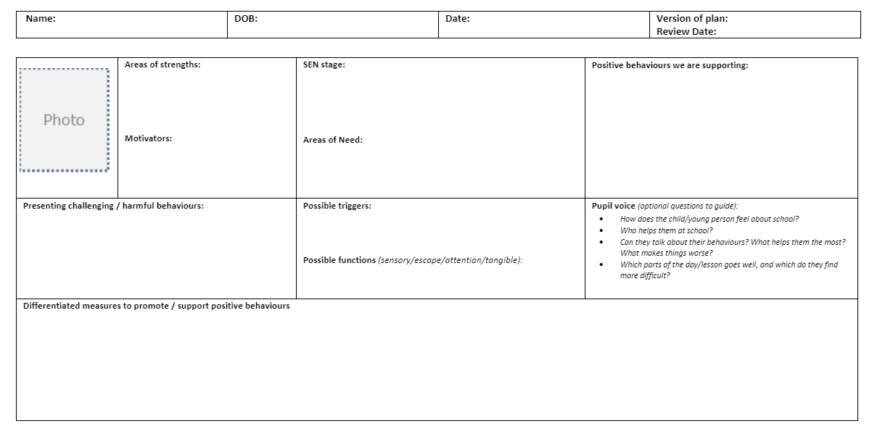
What we need to know:
Notes:
RA

Slide 18
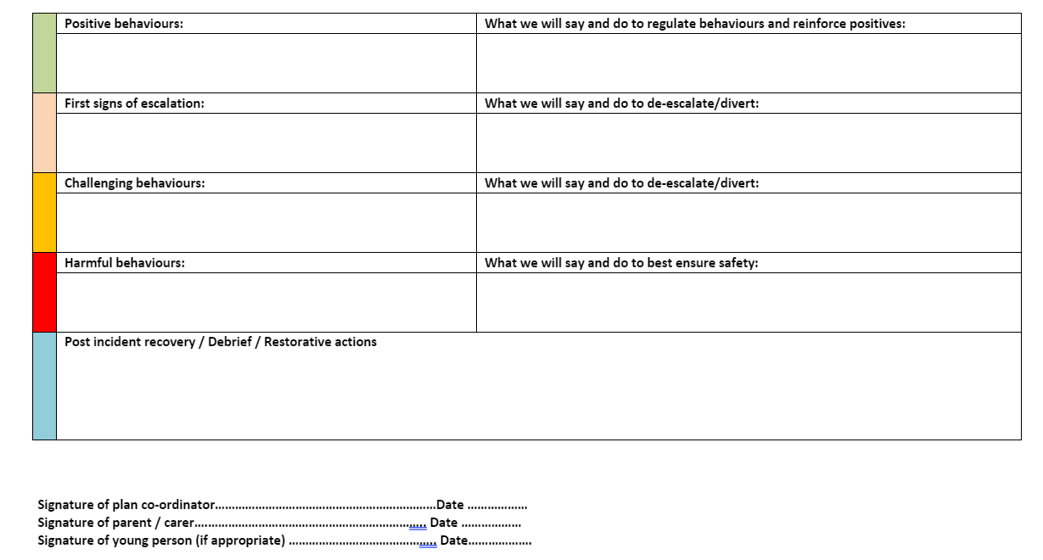

Slide 19
Step Up
Training in restrictive physical intervention (restraint).
All techniques have been risk assessed for physical/psychological risk.
This can be trained by Step Up Lead Professionals in schools/settings.
Step Up Lead Professional training takes 1.5 days.
Step Up LPs MUST have already be Step On LPs.
There must be 2 Step Up Lead Professionals leading training with a maximum of 12 staff who have completed modules 1-8.

Slide 20
Restrictive physical intervention should only be trained where there is an audited need.
Any RPI must be:
Last resort
Only in response to foreseeable or actual harm
Least intrusive (use of minimal force necessary)
For the least amount of time
Reasonable, proportionate and necessary

Slide 21
Norfolk Steps: The local picture
Currently we have:
268 Lead Professionals within primary schools.
36 Lead Professionals within secondary schools.
30 Lead Professionals within Early Years settings.
84 Lead Professionals within special schools.
129 Lead Professionals within non-mainstream services.

Slide 22
The Norfolk Steps Offer
Digital Learning
Norfolk Steps is currently fully funded for all mainstream and specialist schools.
Schools have access to Steps Lead Professional training for up to 2 members of staff alongside the digital e-learning.
Primary schools can access Step On and Step Up Lead Professional training. Secondary schools can access Step On Lead Professional training only.
Non-mainstream settings and specialist services can access adapted Step On and Step Up Lead Professional training.
Step on & Step up Lead Professional training
Ongoing supervision and Next Steps

Slide 23
How to access training?
All schools can sign up to Norfolk Steps training through S4S

Slide 24
Norfolk Steps Timescales
Step On should be refreshed every two years
Step Up should be refreshed annually
Step On and Step Up Lead Professionals attend annual refreshers (Next Steps) to maintain accreditation.

Slide 25



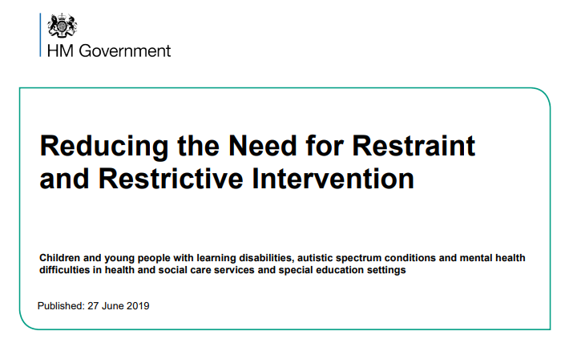


Relevant guidance to support positive behaviour
Mental health and behaviour in schools
SEND Code of practice
Teachers’ Standards
Behaviour in Schools
Use of reasonable force
Reducing the Need for Restraint and restrictive Intervention
*
Notes:
These documents are important guidance - SOLPs need to ensure that guidance relevant to their school/setting is also presented and discussed as necessary.
SOLPs may decide to remove some of the examples given above and insert images of the guidance they wish/need to include.

Slide 26

Attendance News & Current Events

Slide 27


Implementing the National Framework for Attendance – November 2024
We consulted with schools at the beginning of the Summer Term 2024 to inform our response to the introduction of the new national framework for school attendance. We received 104 responses which indicated that, in general, schools felt confident about implementing the requirements of the reforms and we used the results inform the development of guidance and support for schools. Now that the reforms are statutory, we would like to take this opportunity to understand how confident schools feel and identify any additional support needs they may have.
Link to survey – Implementing the National Framework for Attendance

Slide 28

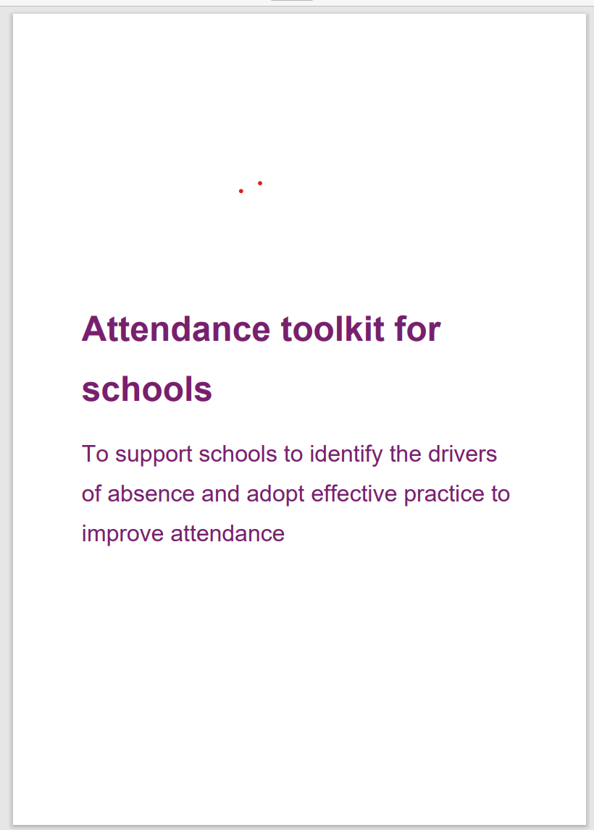




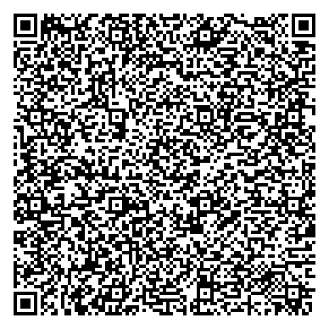

Toolkit |  | Attendance toolkit for schools: six key areas
A toolkit of adoptable practice to support improvement
Data and targeted support
how to gather, share and use attendance data to put in place action to improve attendance.
Culture
how to embed a support-first culture to encourage high attendance and make school a place children want to attend.
People
how to make attendance ‘everyone’s business’ and ensure individuals and teams work together to reduce absence.
Processes and systems
how to develop and implement strong and rigorous processes to identify and respond quickly and effectively to absence
Relationships
how to build strong and positive relationships with pupils and families to understand, then prevent or remove barriers to attendance.
Communications
how to develop and share strong and inclusive attendance communications that convey messages with impact.
Notes:
Schools can now access an attendance toolkit developed in collaboration with Rob Tarn, National Attendance Ambassador, and attendance hub leads. It helps schools identify drivers of absence and adopt effective practice to improve attendance. It provides practical resources across six areas; data and targeted support, culture, people, processes and systems, relationships and communications.

Slide 29



Data sharing & absence returns
In line with The Education (Information About Individual Pupils) (England) (Amendment) Regulations 2024 and the requirements of 'Working together to improve school attendance', all schools are now legally required to share information from their registers with the DfE and the local authority.
Sharing data with the DfE:
From the start of the 2024-25 academic year, schools have a duty to provide attendance information to the Department for Education (DfE) on request. Data indicates that as of 6th September, over 380 have already signed up to share their daily attendance data with the DfE in line with statutory requirements.
Action: It is important that all schools ensure that they have completed this process and for those schools who have not, further guidance on how to share your data is available via this link: Share your daily school attendance data - GOV.UK (www.gov.uk)
Once you are sharing data with the DfE you will have access to a range of tools that will support you to analyse your data. The DfE has published guidance for schools, academy trusts and local authorities on using the monitor your school attendance tool.
Sharing data with the LA:
Further, to facilitate timely collaborative working across partners, all schools are also required to share information from their registers with the local authority. As a minimum this includes:
New Pupil and Deletion returns
Attendance returns
Sickness returns
If your school is not currently sharing data as part of the local arrangements, you will receive an e-mail from attendancedatacollection@norfolk.gov.uk within the next two weeks providing guidance on what you need to do next.
If you already provide attendance data to the LA via the local arrangements, please also contact attendancedatacollection@norfolk.gov.uk if:
You have changed Management Information System provider over the Summer as this will impact on data collection.
You are unsure of who we hold as your contact for the local data feed and/or would like to make a change to the contact.
Notes:
As an LA, we want to reduce the administrative burden placed on schools as well as support them to meet with national requirements. As a result, we need schools to engage with both our local attendance data arrangements as well as the DfE collection of attendance data. This is because the DfE does not currently provide the facility to export data relating to sessional attendance codes which are required for the purpose of the sickness and attendance returns. As the DfE systems develop, we envisage that we will be able to cease the local collection of data and are providing feedback on proposed future development of the national system. Engaging with both systems simultaneously will not add to schools workloads nor compromise information security.

Slide 30
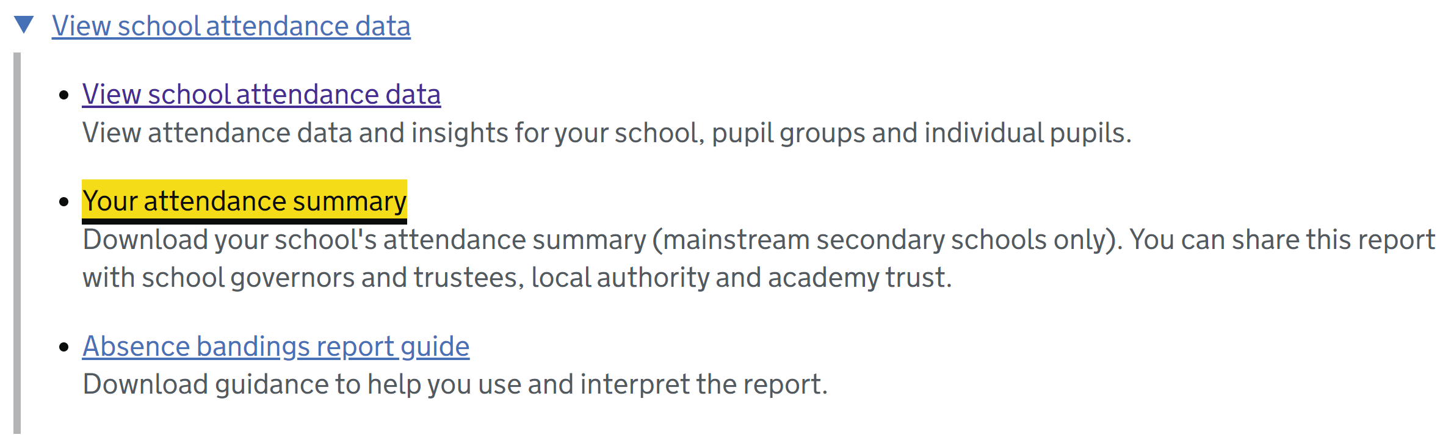
30

Slide 31

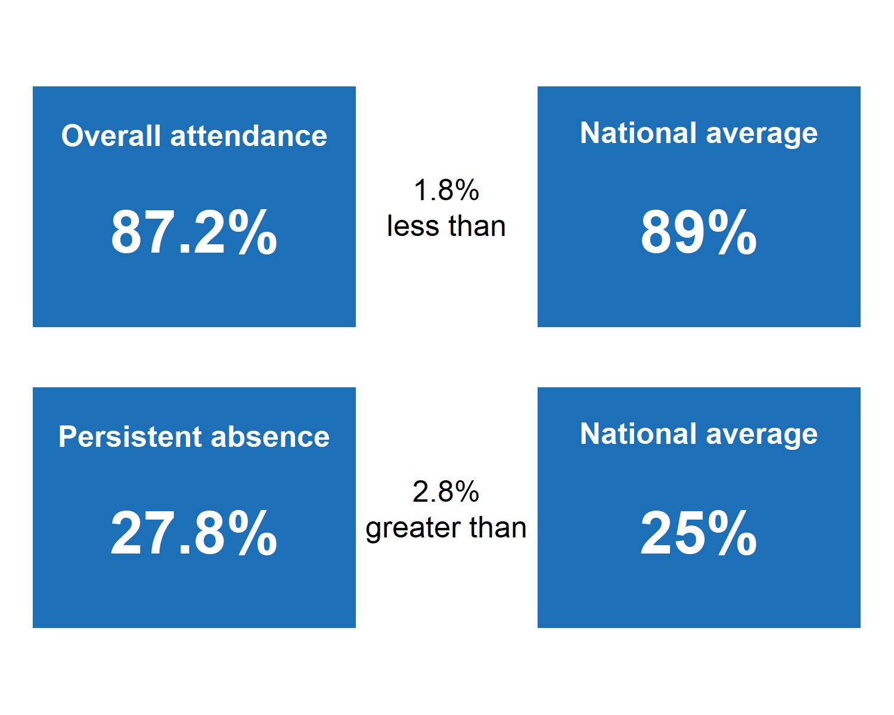
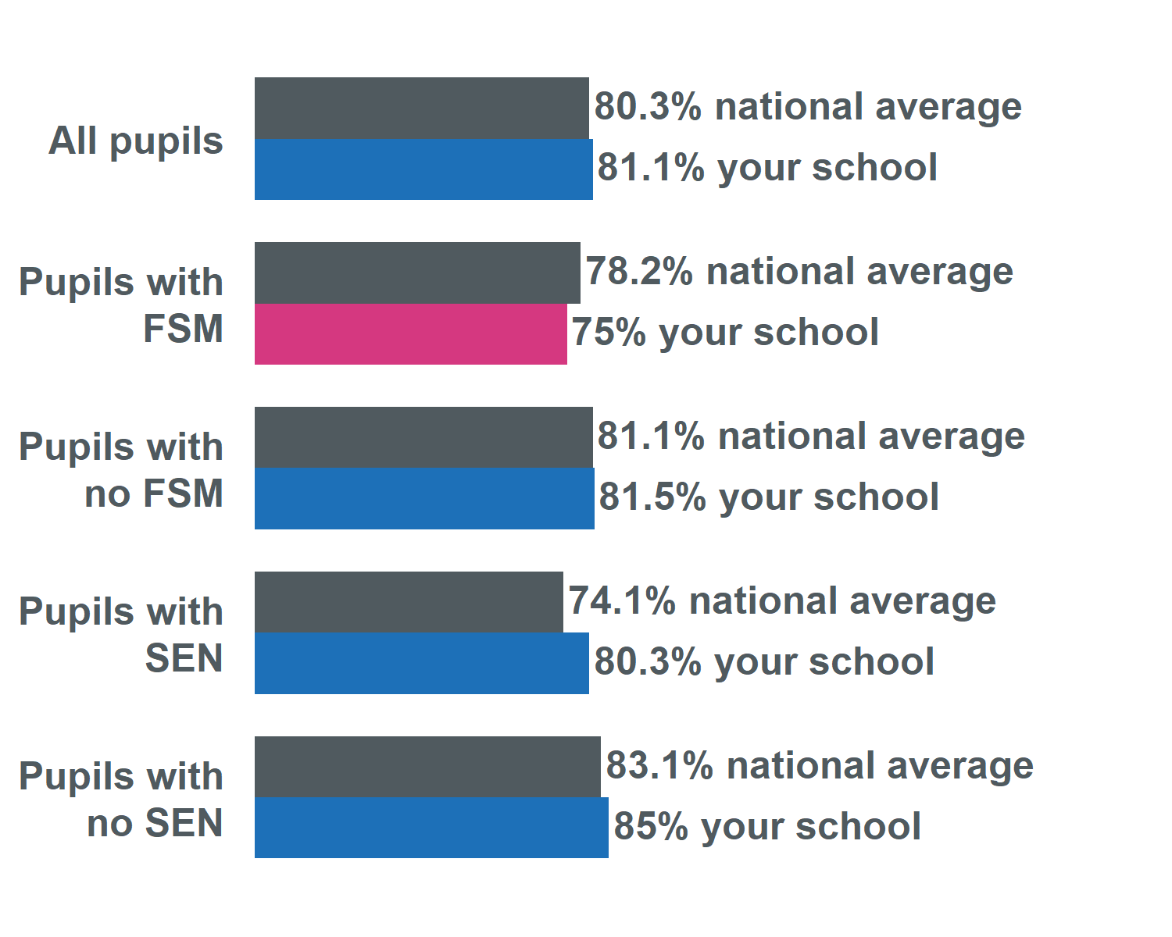
Your Attendance Summary report
Reports will be distributed half-termly and contain:
Comparisons of your school’s overall attendance and persistent absence with the national average, both overall and split by FSM eligibility and SEN status
Specimen content – all figures indicative only

Slide 32

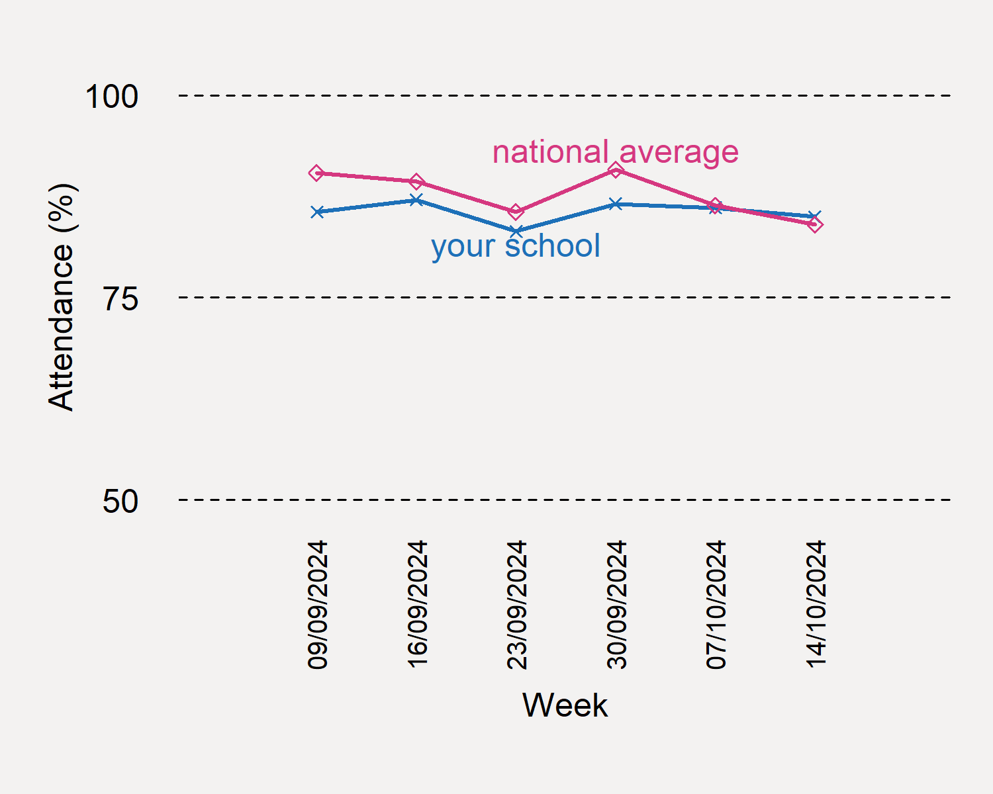
Your Attendance Summary report
Reports will be distributed half-termly and contain:
A week-by-week comparison between your school’s overall attendance and the weekly national average
Specimen content – all figures indicative only

Slide 33

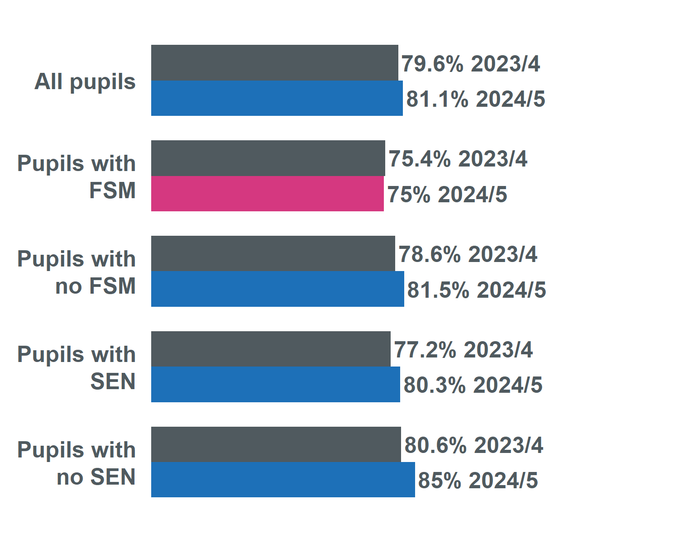
Your Attendance Summary report
Reports will be distributed half-termly and contain:
Comparison of your school’s overall attendance with the same period in the previous academic year, both overall and split by FSM eligibility and SEN status
Specimen content – all figures indicative only

Slide 34

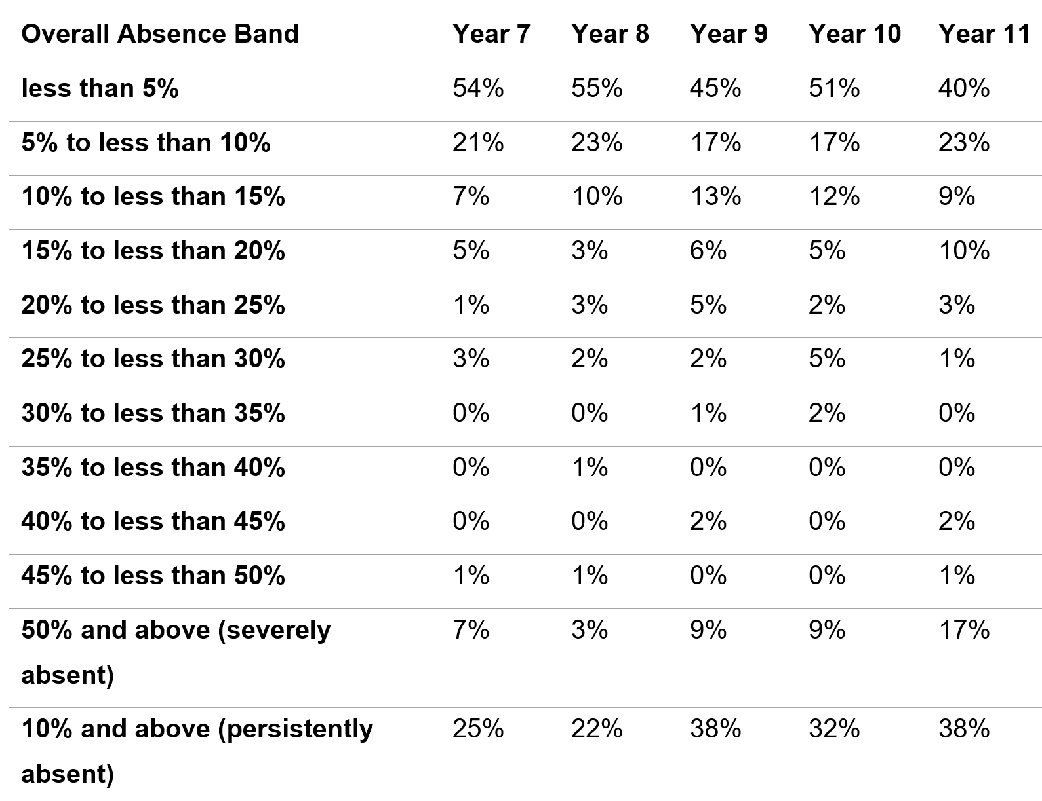
Your Attendance Summary report
Reports will be distributed half-termly and contain:
Absence banding table split by year group
Specimen content – all figures indicative only

Slide 35


How can I use my Attendance Summary report?
Share it with governors, your local authority and academy trust as part of conversations on how to improve attendance
Identify areas to dive further into using other tools in View Your Education Data (the reports contain instructions for how to investigate further)

Slide 36
Targeting Support Meetings
Schools are expected to participate in these meetings in line with 'Working together to improve school attendance.' The number of meetings a school is expected to have is outlined within the DfE guidance and depends on the level of the attendance challenges in the school:
If your school's attendance levels were below the national average for your phase, it is expected that you book a TSM for each term
If your school's attendance levels were above national average for that phase, you may if you want only schedule one TSM for the academic year.
We would encourage all secondary schools in Norfolk to book a TSM for each term, whether above or below national average. If your setting's attendance rates are above the national average for your phase and you wish to meet with us termly, you are welcome and invited to do so.
Booking your TSM
To book your TSMs for the academic year:
Visit the following page: NCC Targeting Support Meeting Bookings
Select the meeting type that applies to your school setting.
Select the date you wish to book in the calendar.
Select a time from the available options.
Add your details into the required fields, ensuring to include the name of your school.
Select book and you will receive an email confirmation of your booking.
Please note:
If you wish other colleagues to attend, you can forward the meeting invitation.
When booking a meeting for each term, you will need to repeat this process for each booking.
If a date or time is unavailable that is because the slot is already booked, or the date falls outside of term-time based on the Norfolk calendar.
Notes:
Targeting Support Meetings (TSMs) are essential for early identification and support of pupils with habitual attendance issues, requiring collaboration between schools, local authorities, and partners. Local authorities are expected to organise these meetings regularly with each school to build strong relationships, discuss overall trends and emerging trends in the school's attendance data, identify and agree on action plans for severely absent pupils, and discuss approaches for persistently absent pupils needing multi-agency responses.

Slide 37


Save the date!
Attendance Spotlight Webinars
Will be held approximately on the last Thursday of each month. They will begin at 10.30am and can be accessed via the links in the Upcoming events section of Attendance news and events page. Autumn Term schedule:
23rd January 2025
6th February 2025
27th March 205
24th April 2025
22nd May 2025
3rd July 2025
Countywide Attendance Network Meetings
Spring Network Meeting: Thursday 27th February
Summer Network Meeting: Thursday 26th June
All held in person at The Inspiration Teaching Hub.
Keep up to date with Attendance news and events via:
Attendance news and events page
And by registering to receive weekly emails and updates from the News for Norfolk Education Providers.
Webpage for News for Norfolk Education Providers can be found here.

Slide 38

Further support and guidance can be found at:
School attendance - Schools (norfolk.gov.uk)
If you have any further questions that have not been answered today, then please contact the Attendance Team on 01603 233681 or at csattendance@norfolk.gov.uk

